Slide 1
Preparing Anime-Style 3D Characters for Godot Using Blender
@CoderNunk (Jesse)
GodotCon May 2025

Slide 2
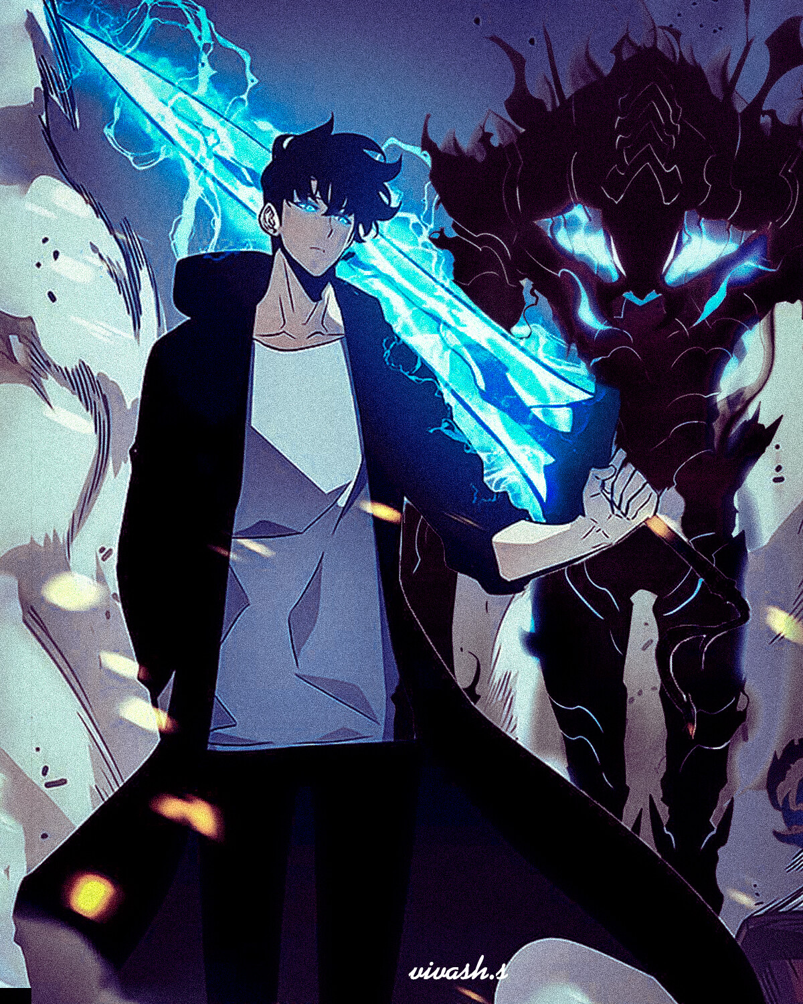
What Makes Anime Appealing?
Vivid colors and shading
Exaggeration of proportions to convey cuteness, strength, etc.
In between cartoons and traditional animation - less details make it easier to animate but added details for appeal
Allows for a broad range of expression in character design

Slide 3
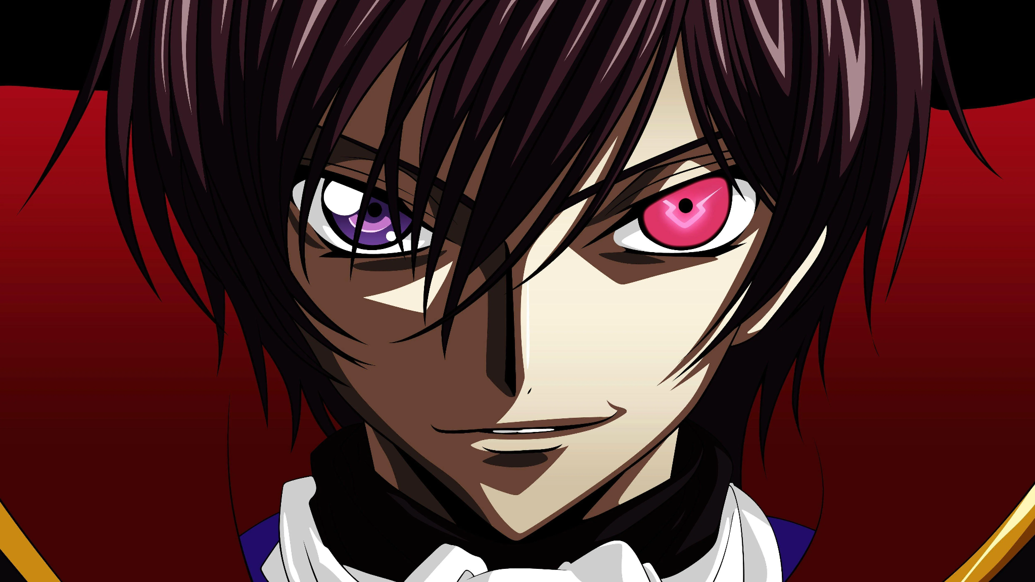
What Defines the Anime Look?
Increased range of movement on face and body (can break physical conventions in animations to sell impact)
Colors and shadows are defined and intentional
Cel shading relies on flat shadows

Slide 4
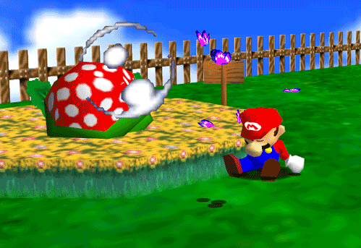
What Makes Video Games Appealing?
Dynamic outcomes based on player input
Engaging stories told through gameplay
Becoming the character you play
Playing with others

Slide 5
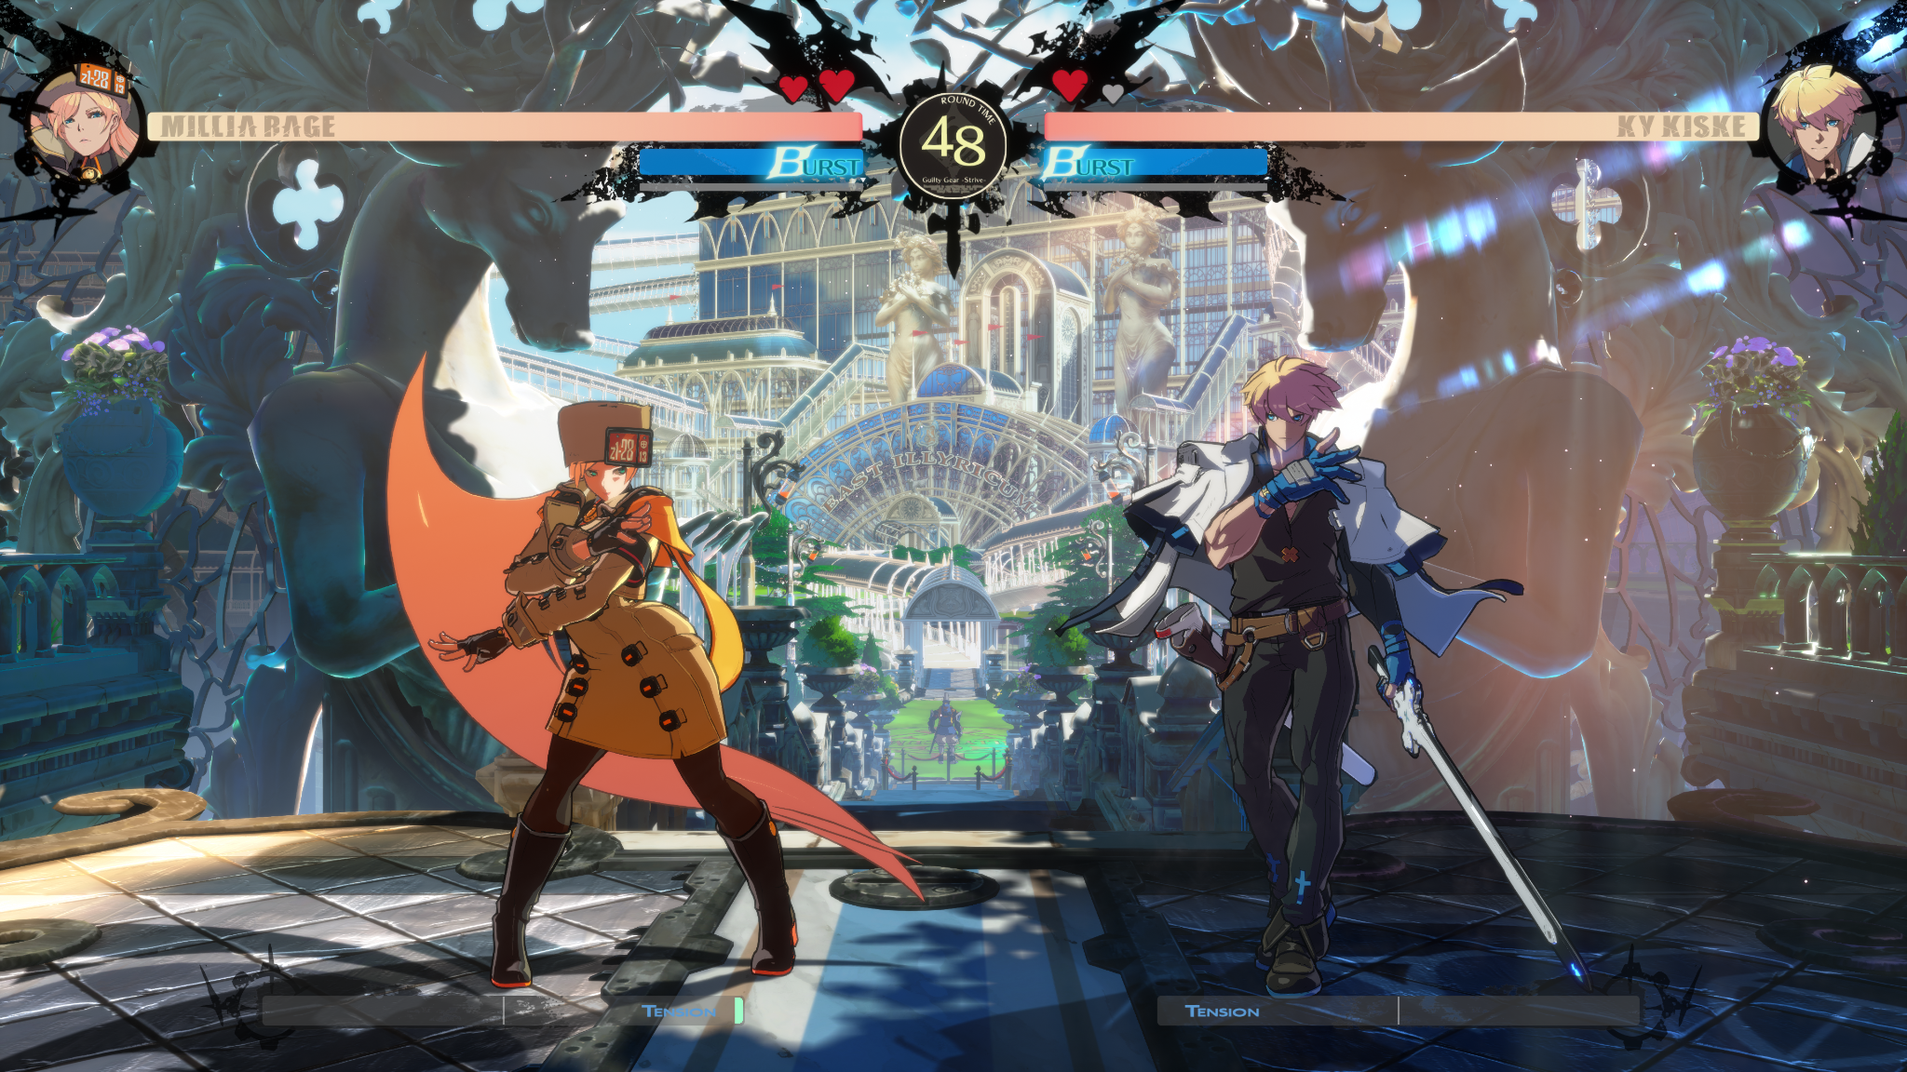
Combining Anime and Video Games
So, what if we combined anime and video games?
We’ll get a wide range of character expression, fantastic story potential, and potentially awesome gameplay systems
The hand-drawn look will look awesome in a dynamic setting

Slide 6
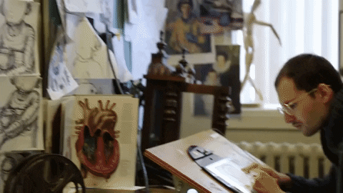
However…
Drawing anime frame by frame is predictable and doable, as episodes are static
But in a video game setting, you need to account for a lot of variable animations
That’s just not feasible to do with drawing alone…

Slide 7
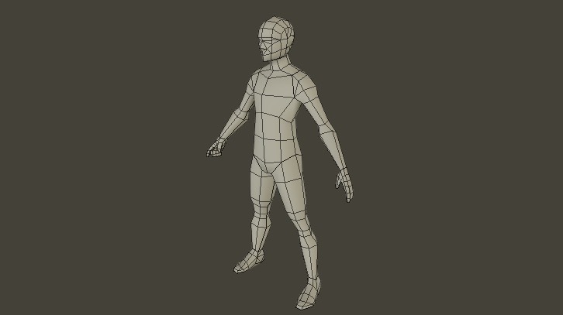
Enter 3D Models!
3D Models provide more flexibility with animation than 2D sprites, as they can be rigged and can share animations between rigs
Gains all the benefits of 3D - such as customization, camera flexibility, etc.
But… is it possible to sell the anime look with 3D?

Slide 8
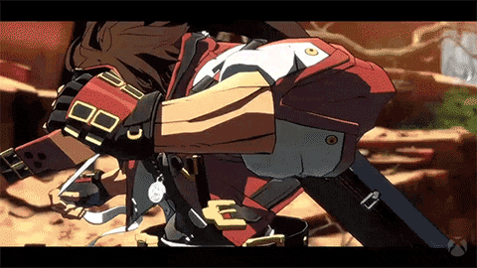
Yes!

Slide 9
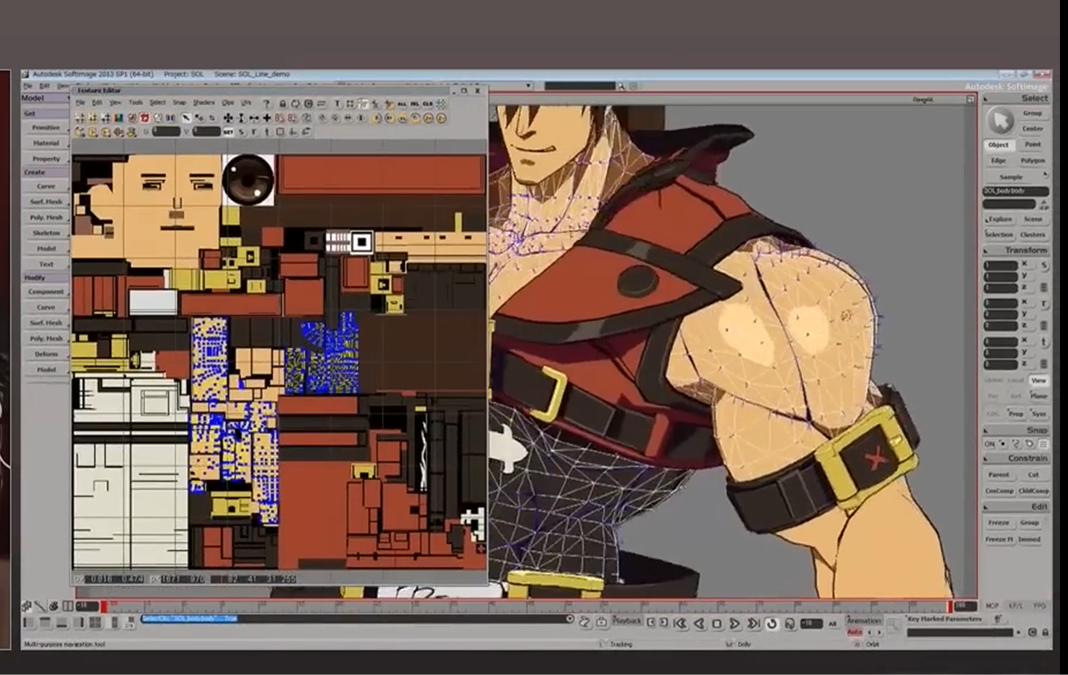
How is this possible?
Arc System Works pioneered the anime 3D style with Guilty Gear Xrd
By bending the rules of 3D, there are ways to convince the players it looks like anime
Normals on a 3D model can be modified to influence light
UV mapping and texturing are done differently to make linework cleaner
Vertex colors can be used to store data used in the shader

Slide 10
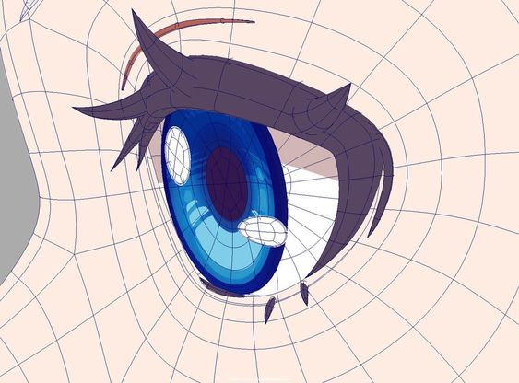
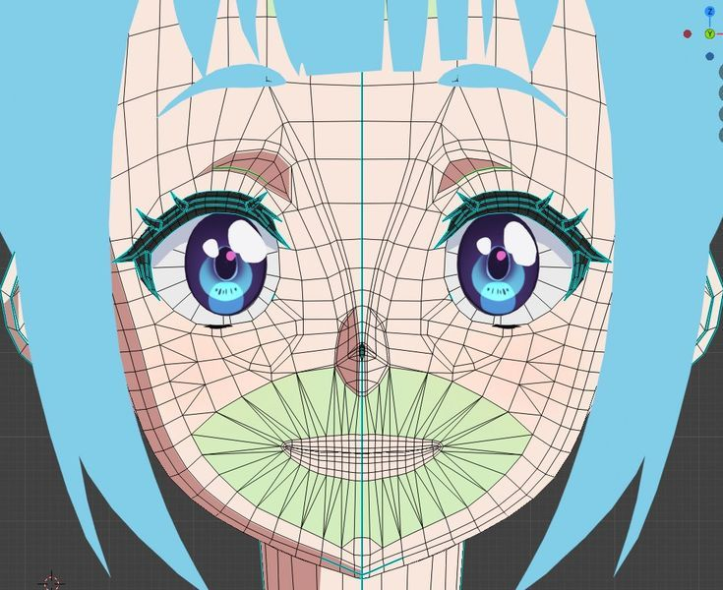
Stylized vs Traditional 3D
Topology is more intentional for faces to get the most out of animation and normals on anime models
Due to flat shading, texturing could potentially be simplified
Since anime style is more artistic, there’s more intentionality in how shadows are rendered
Less reliance on normal/bump maps but use vertex paints or secondary texture maps to control shading
Model is built to exaggerate more

Slide 11
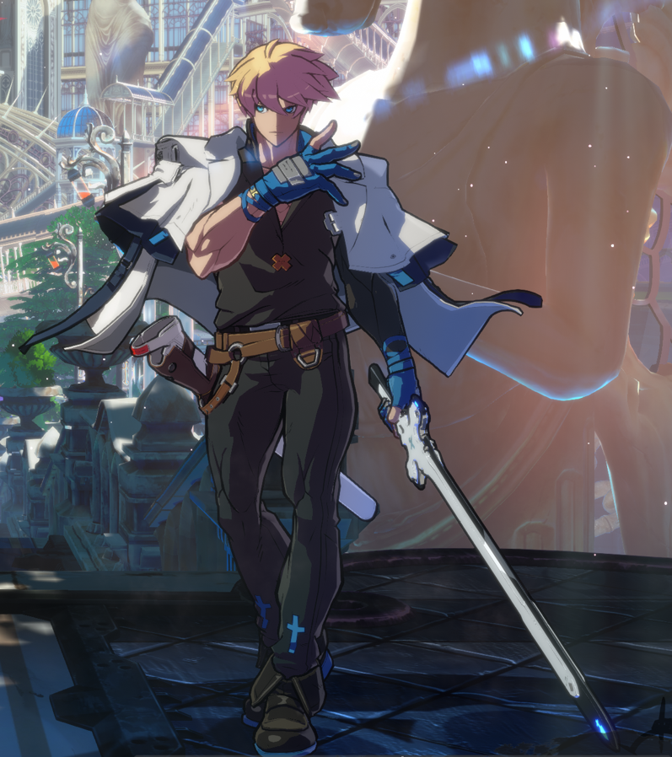
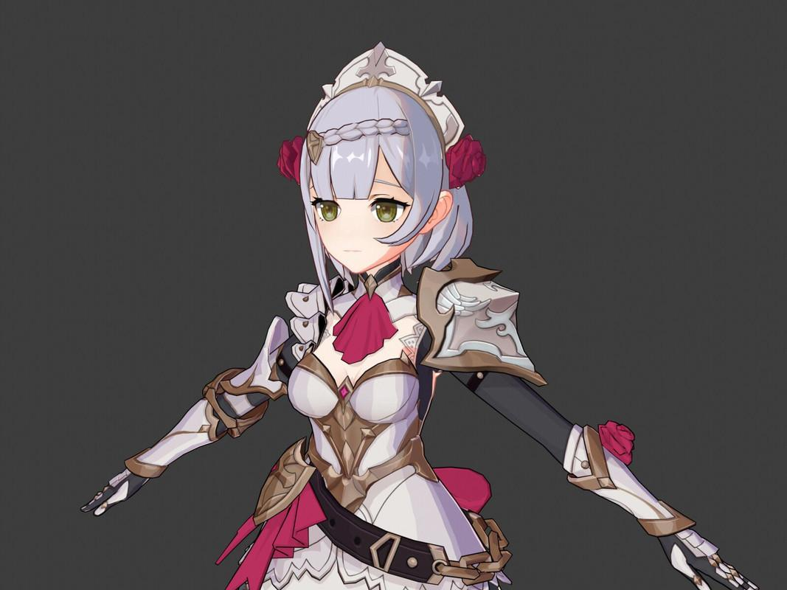
Flavors of Anime Style
Guilty Gear: Hard edge lighting, 2.5D, aggressive stylization (have a large amount of control for each frame)
Genshin Impact: Softer shading, painterly textures, mobile optimized (function much more like a traditional 3D model)
My style is much more simplified to help work within my artistic constraints

Slide 12
Let’s Begin the Workshop!

Slide 13
Starting the Workshop! (Resources and Add-Ons)
Blender version 4.4.3
Godot version 4.4.stable
Latest version of Blender add-ons are provided in workshop files
Expy Kit (for rigging)
Vertex Color Master
I encourage you to use your own 3D models to follow along!
The resource files are broken down by step for your reference, but you can continuously work from the starting files
Resource files: https://github.com/codernunk/godotcon-anime-style-2025

Slide 14
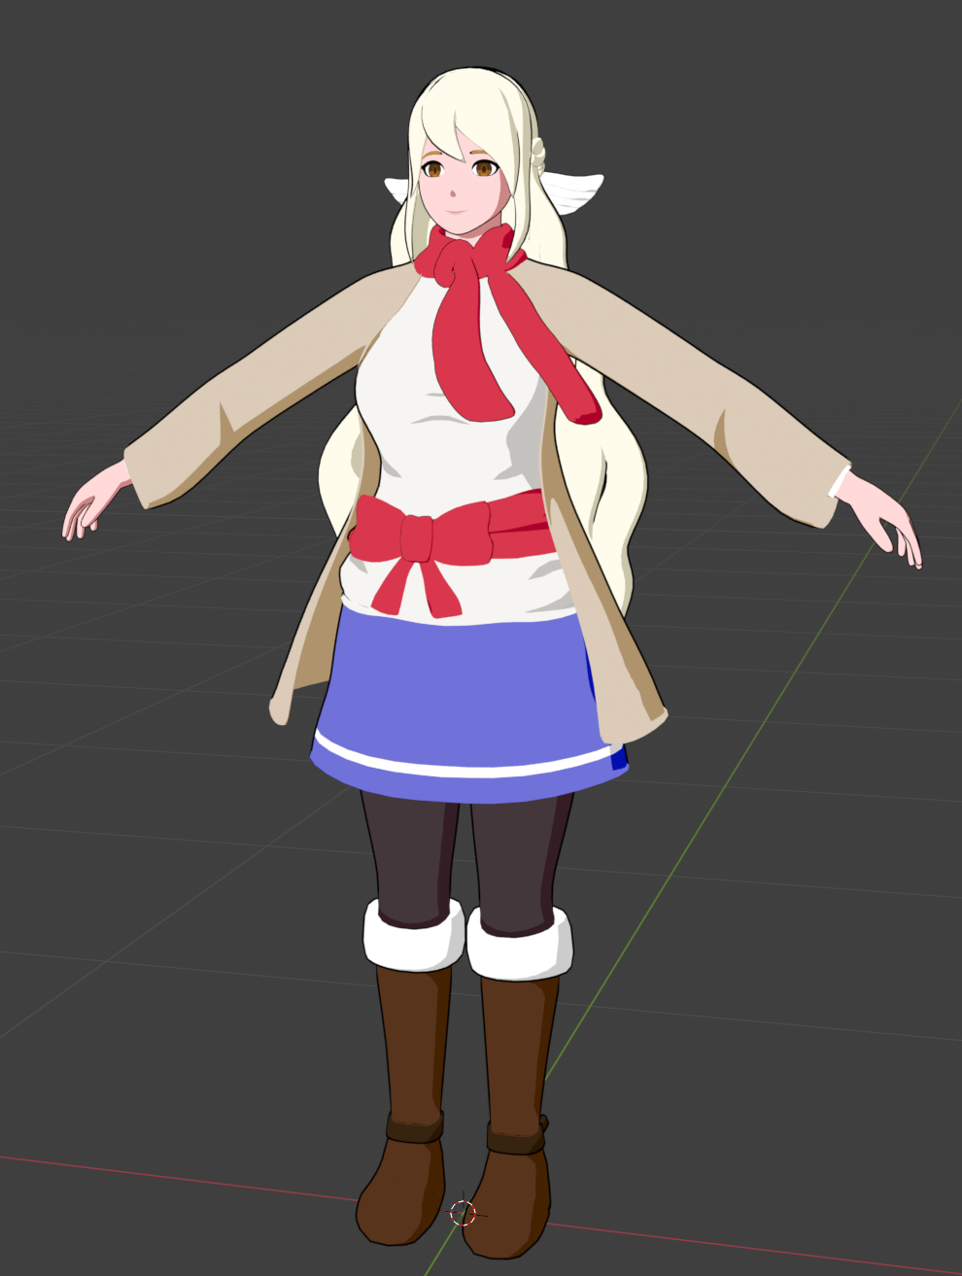
Disclaimers
You are welcome to use my character, Kaila for the workshop!
She is under a Creative Commons license, so she’s free to use for educational purposes but not for commercial purposes
I won’t be showing all the Guilty Gear techniques, but rather some simplifications that work for my game

Slide 15
Texturing and Shading

Slide 16
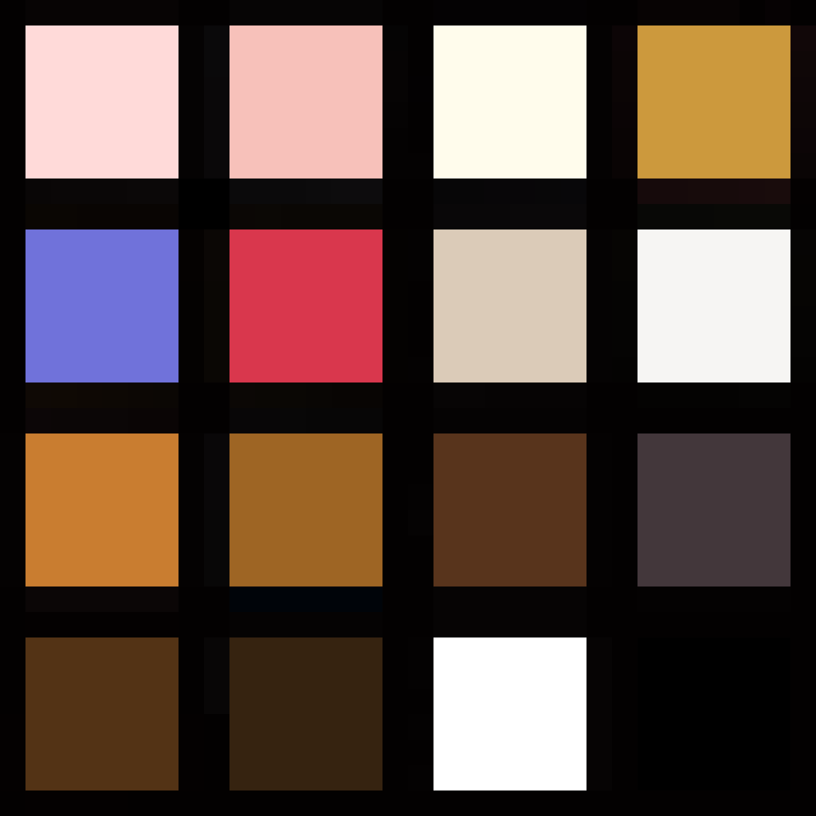
UV Mapping - The Texture Atlas Technique
If your art style relies on very little detail, you can greatly simplify your texturing experience with atlas textures
This technique uses a very small texture split into zones with flat colors
Then you can unwrap your model and place the parts in the desired colors
You don’t have to worry about the UVs being perfect!

Slide 17
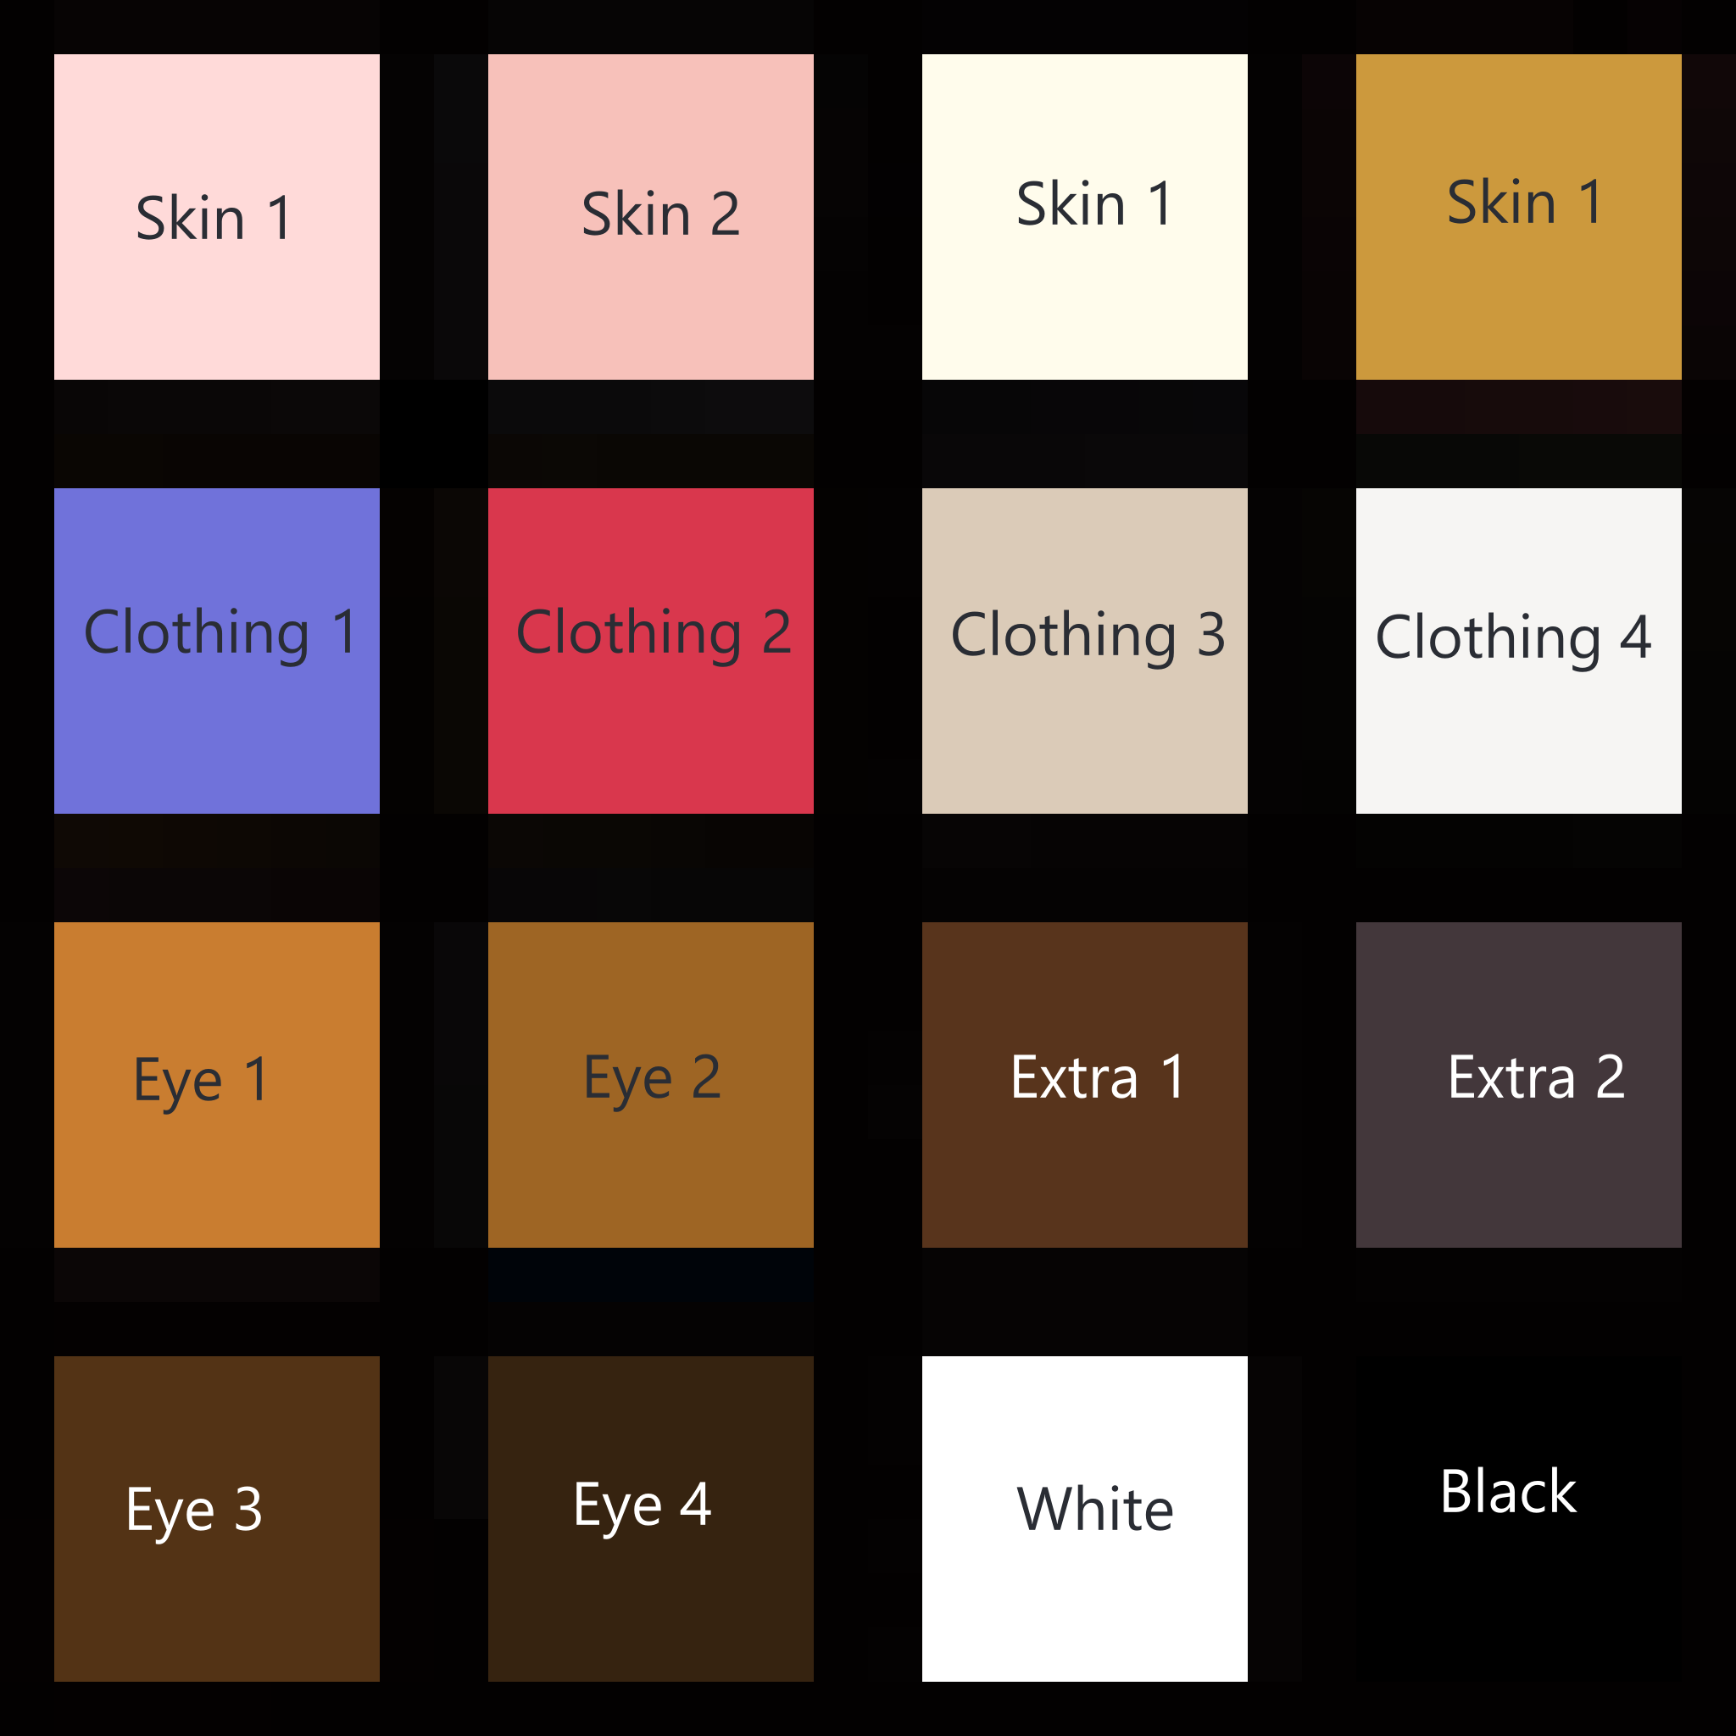
Implementing the Texture Atlas
Create a 32x32 image, either in Blender or in an external image program
Fill in some base colors that you think you’ll need.
Here’s how I organized mine - feel free to use this

Slide 18
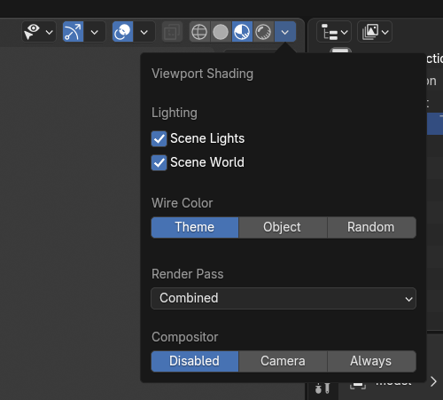
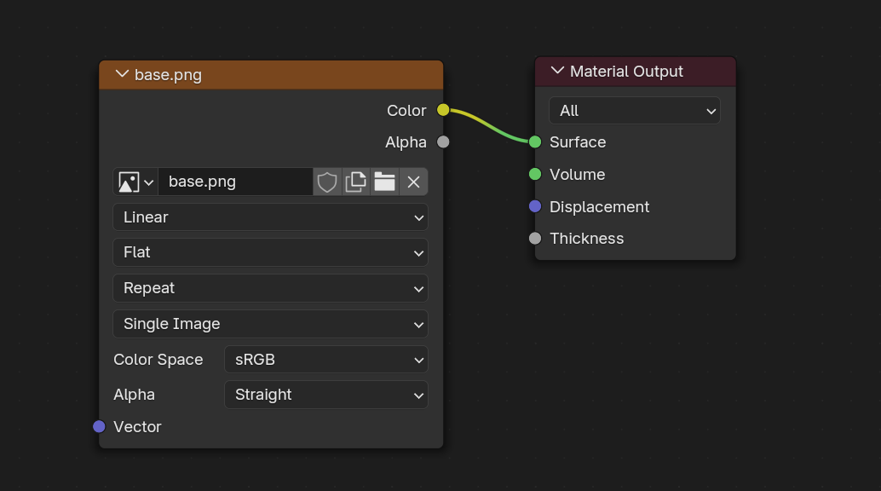
Before UV Unwrapping
Import your texture atlas into your Blender file
Create a new material that just has your image texture plugged into the output
In Shader workspace, set viewport shading to use Scene Lights and Scene World
Remove Principled BSDF and add an Image Texture node
Connect to Material Output

Slide 19
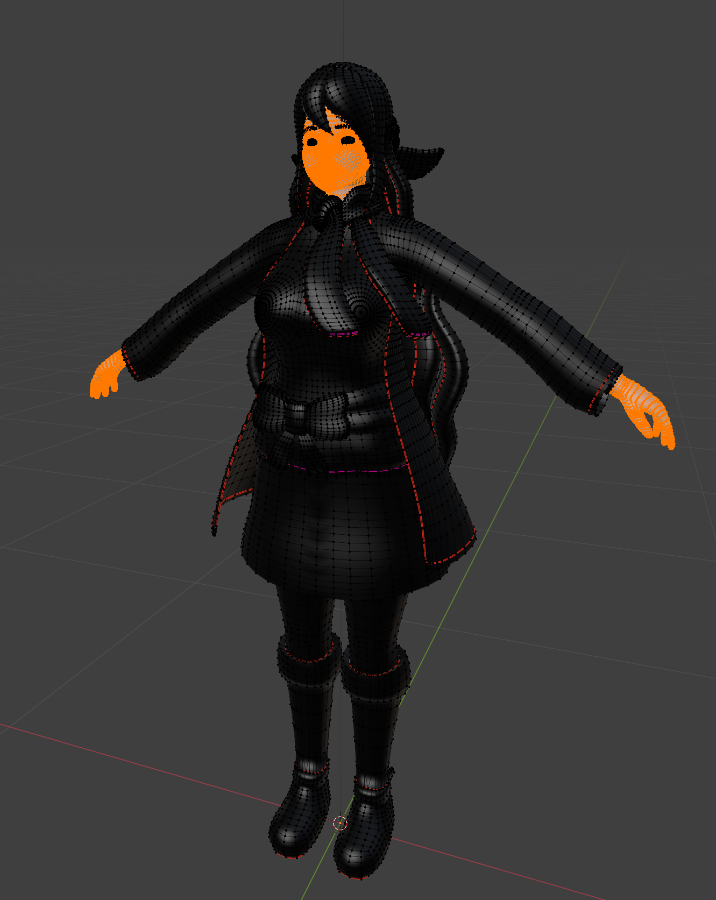
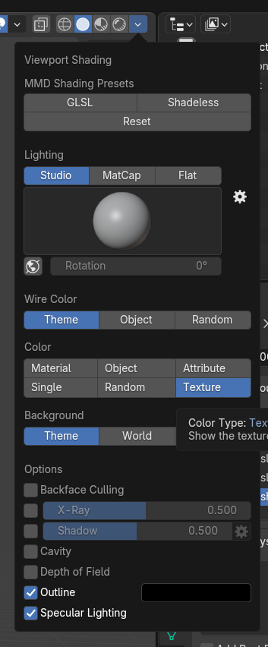
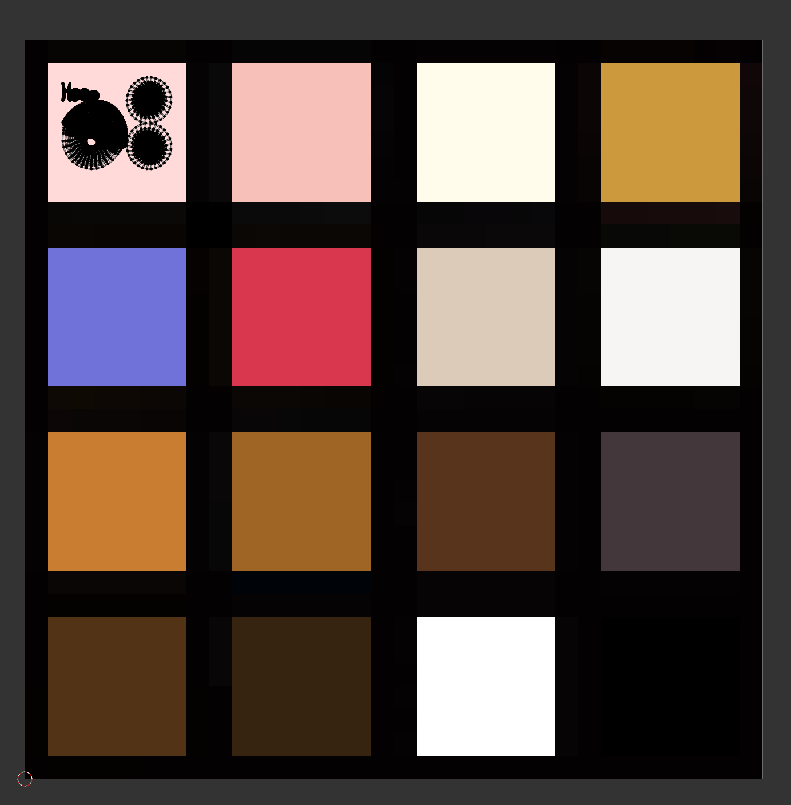
UV Unwrapping
In the Viewport Shading settings, set the Color to “Texture” to make previewing easier (or use Material Preview shading mode)
Enter Edit mode on your model, and use the L key to select linked
Select all parts that would share the same color, then press U to unwrap, then move to the correct color square
Repeat for the rest of your model
Use the Texture Paint feature in Blender to adjust the palette as needed

Slide 20
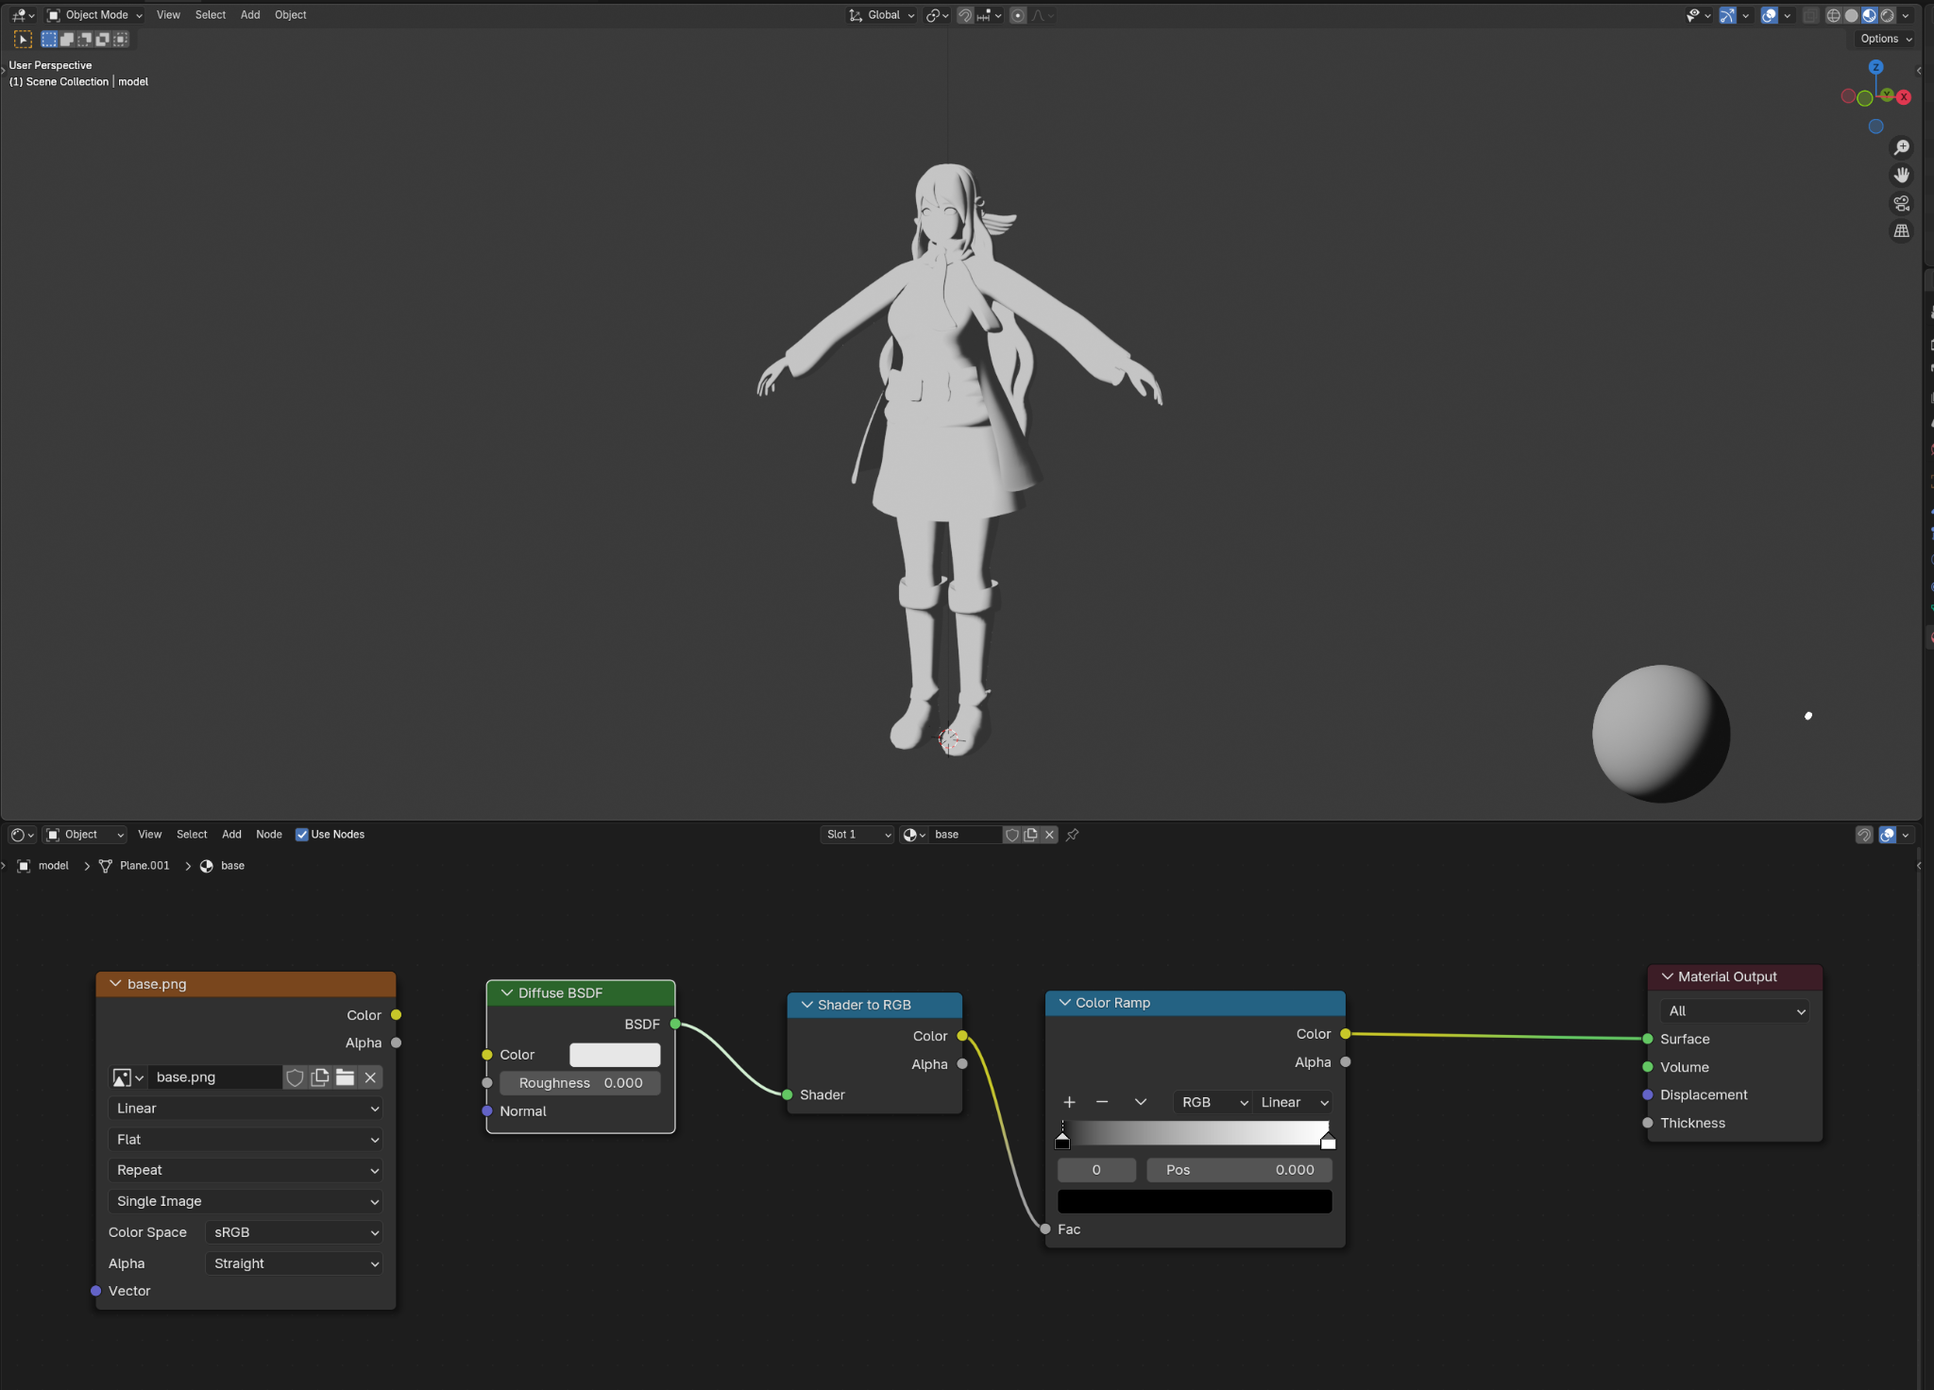
Building the Toon Shader (Blender)
Open Shading workspace
Change to Scene Lights and Scene World under render preview settings
Select the model and add a new material
Open Shader Editor and unplug Image Texture Node
SHIFT + A to add Diffuse BSDF, Shader to RGB and Color Ramp

Slide 21
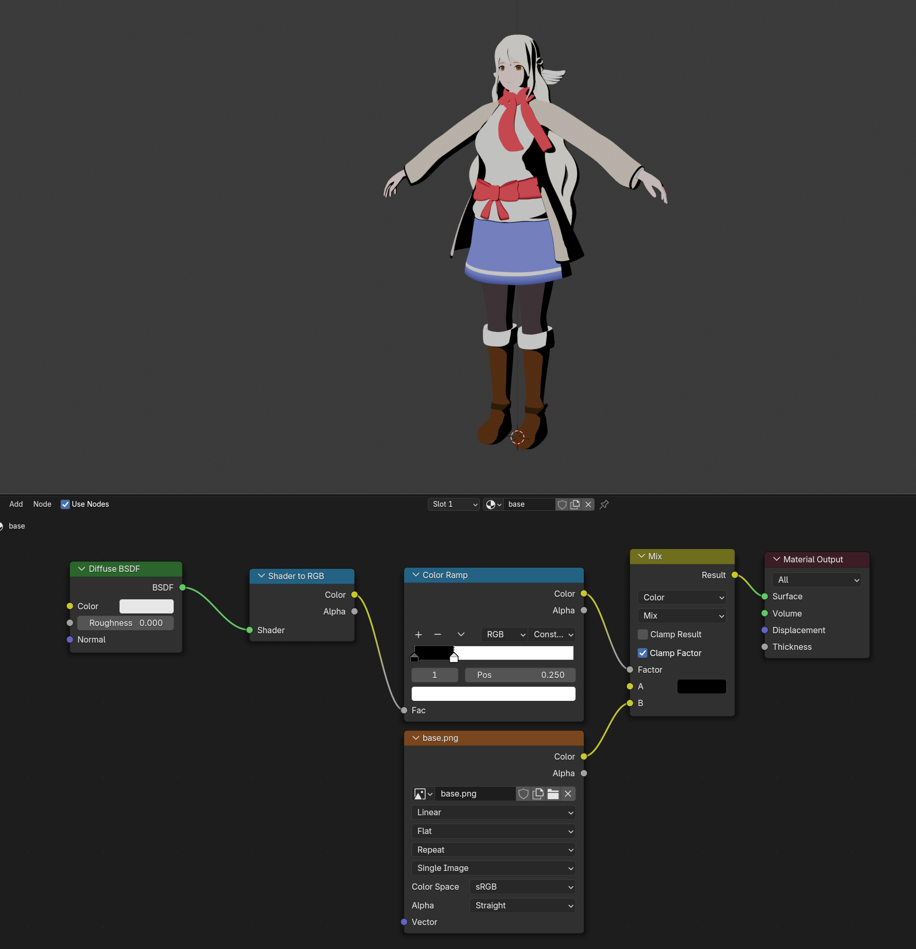
The ColorRamp Node
This node limits values of the color inputs to a range defined by you
The Constant type makes the shadows solid
After adjusting color ramp, add a Mix Color node and connect the Image Texture to it
ColorRamp should go into Factor, set A to Black (for now) and Image Texture to B

Slide 22
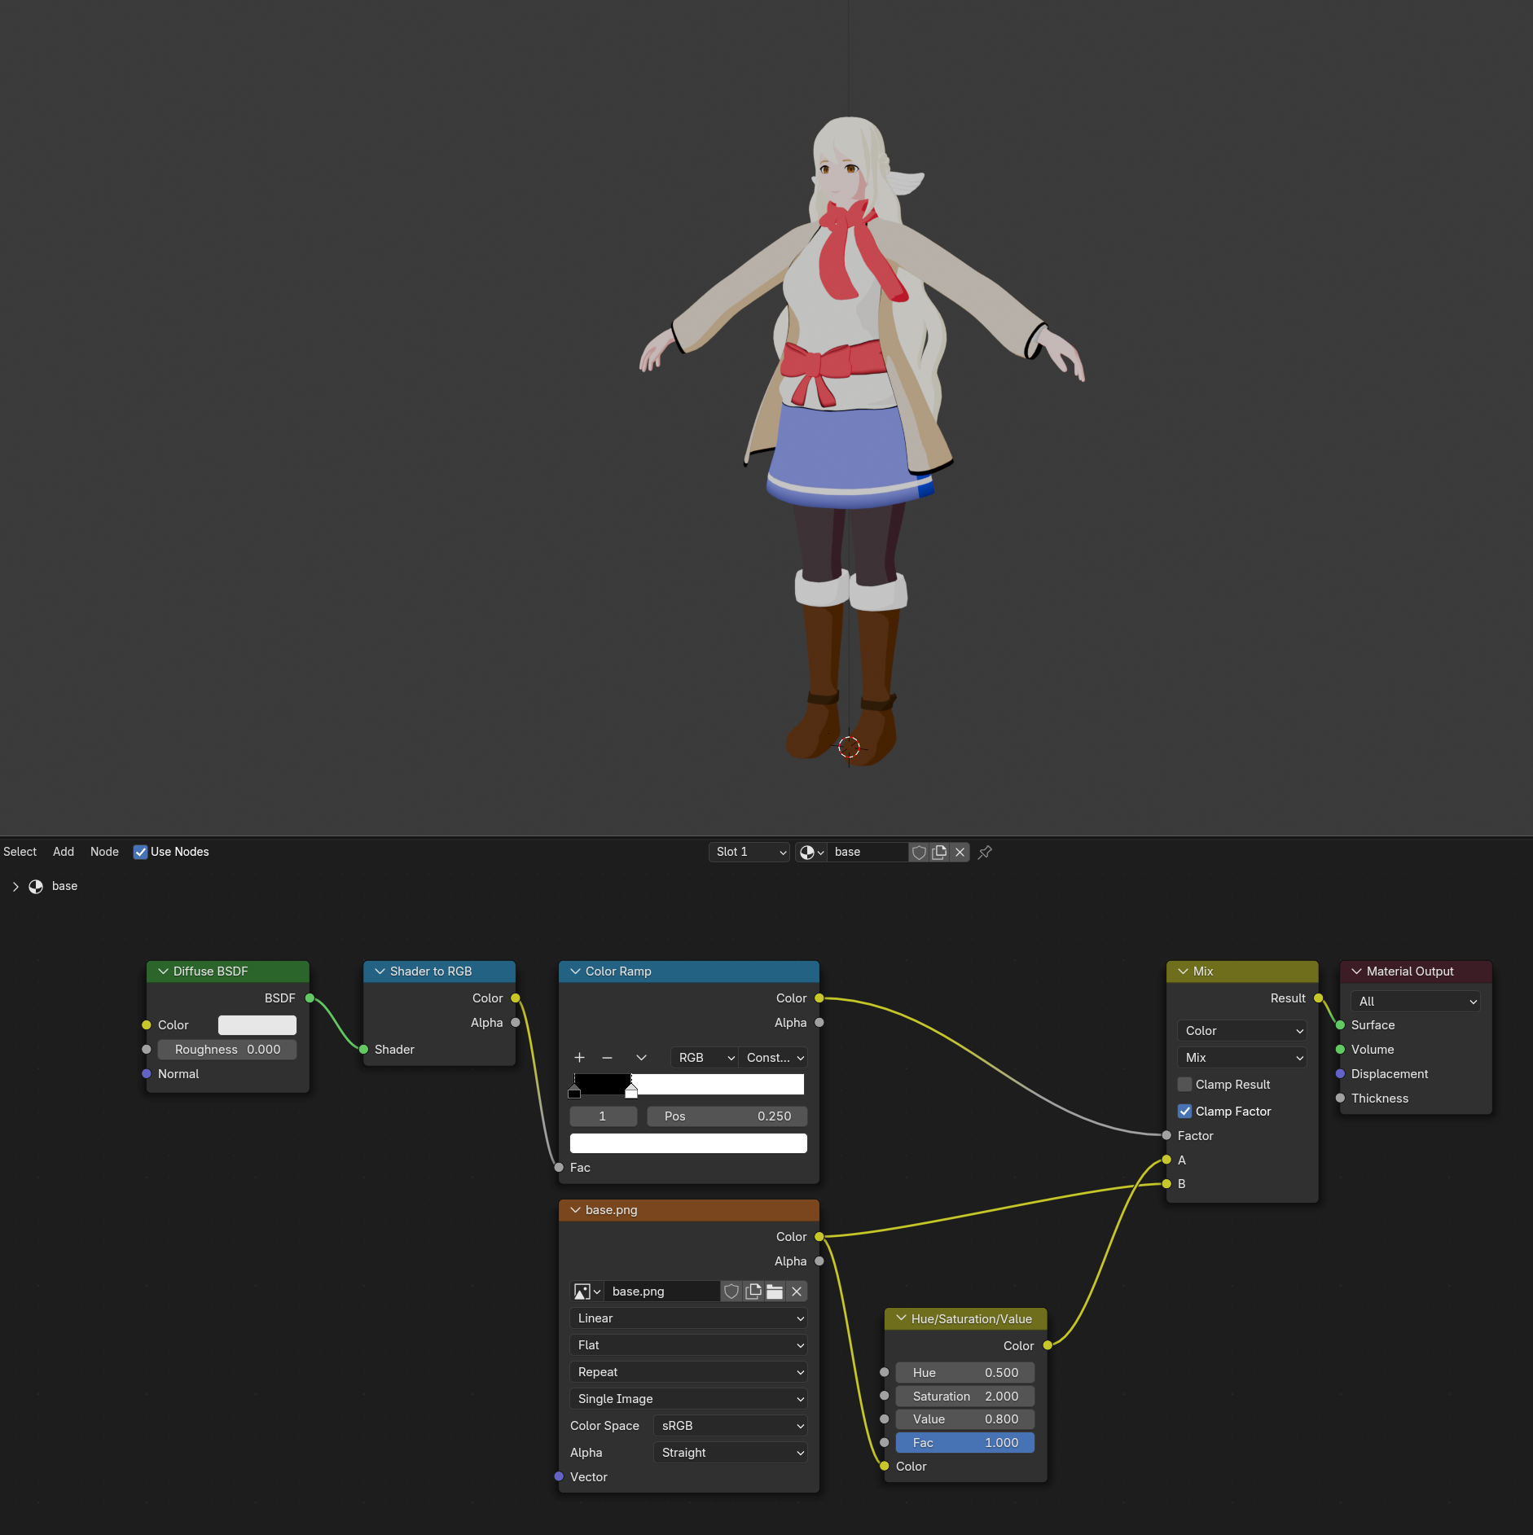
Enhancing the Shadows
We’ll calculate the shadow color with the shader here but you can also make a separate texture for shadow colors
Add a Hue/Saturation/Value node and set Hue = 0.5, Saturation = 2, Value = 0.8
Connect the Image Texture into HSV node
Replace the black with the value of the HSV node

Slide 23
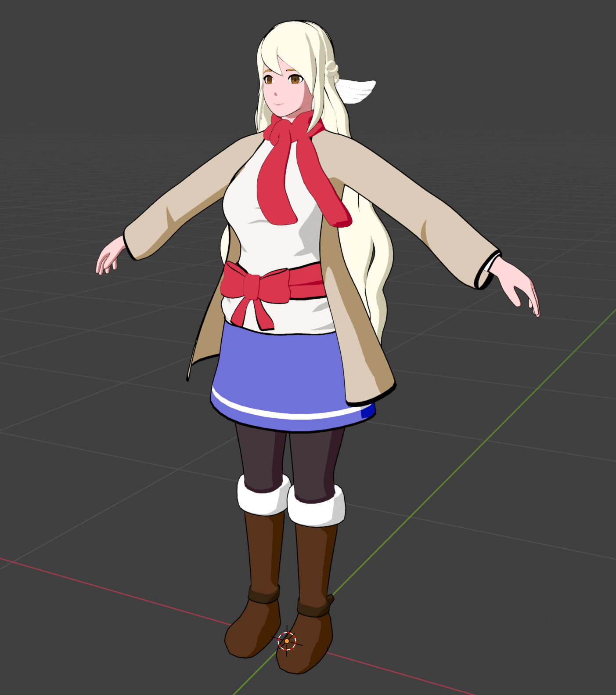
Outlines
Inverted Hull method is commonly used in video games to simulate outlines
It’s the easiest method by far
The caveat is that it adds some additional vertices to your model and also can have clipping problems

Slide 24
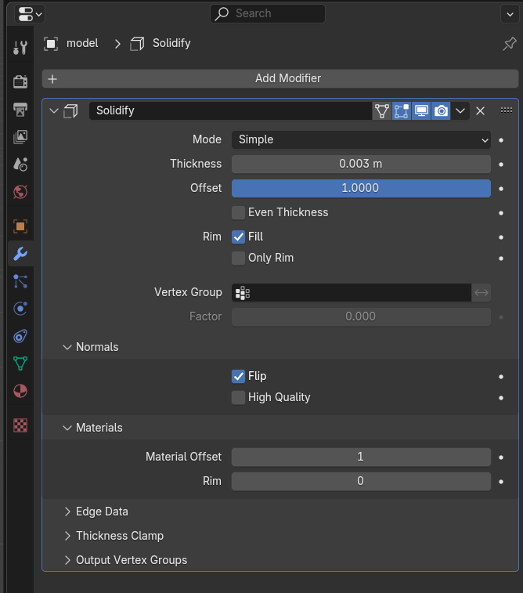
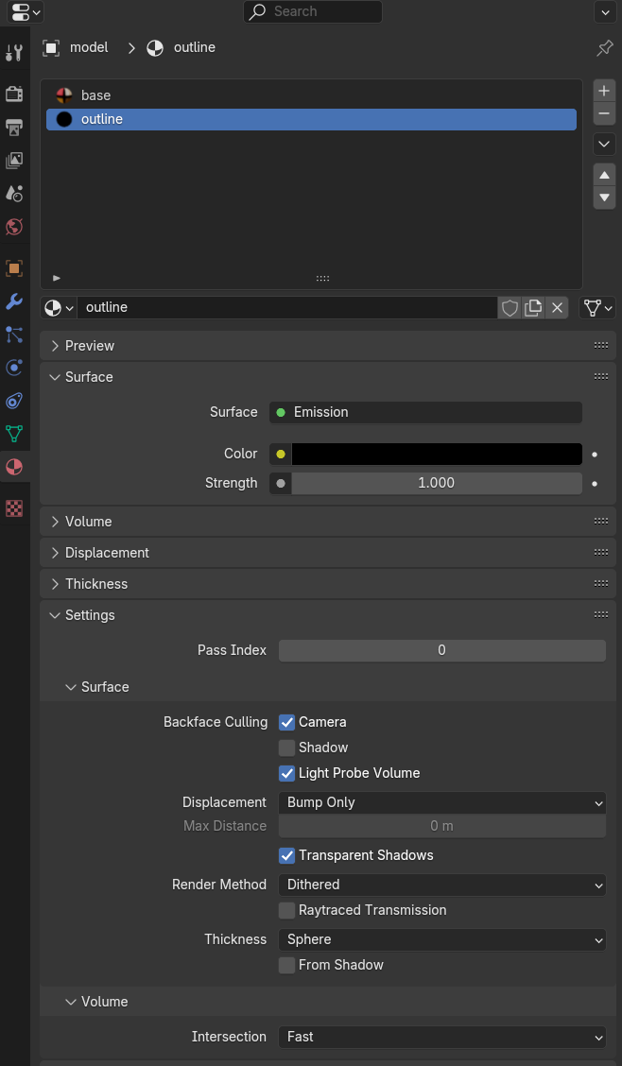
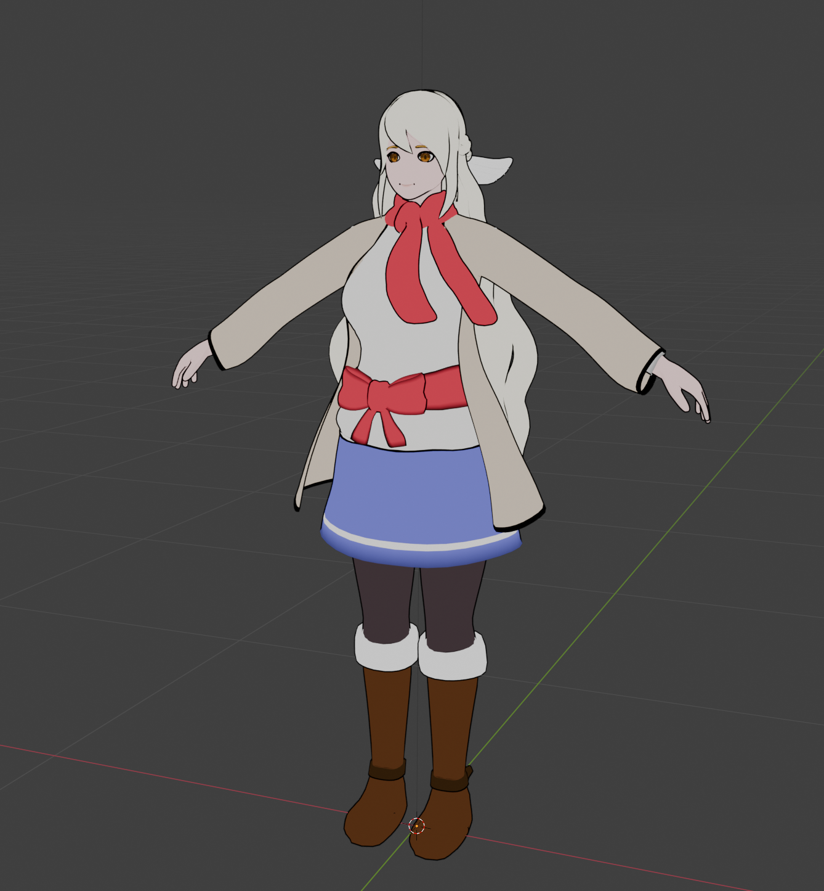
Adding the Outline
Select the character model
Add the Solidify modifier
Flip Normals and change thickness
Create a second material
Backface culling on
Black emission shader
Assign the material index on the Solidify modifier to 1 to target outline material

Slide 25
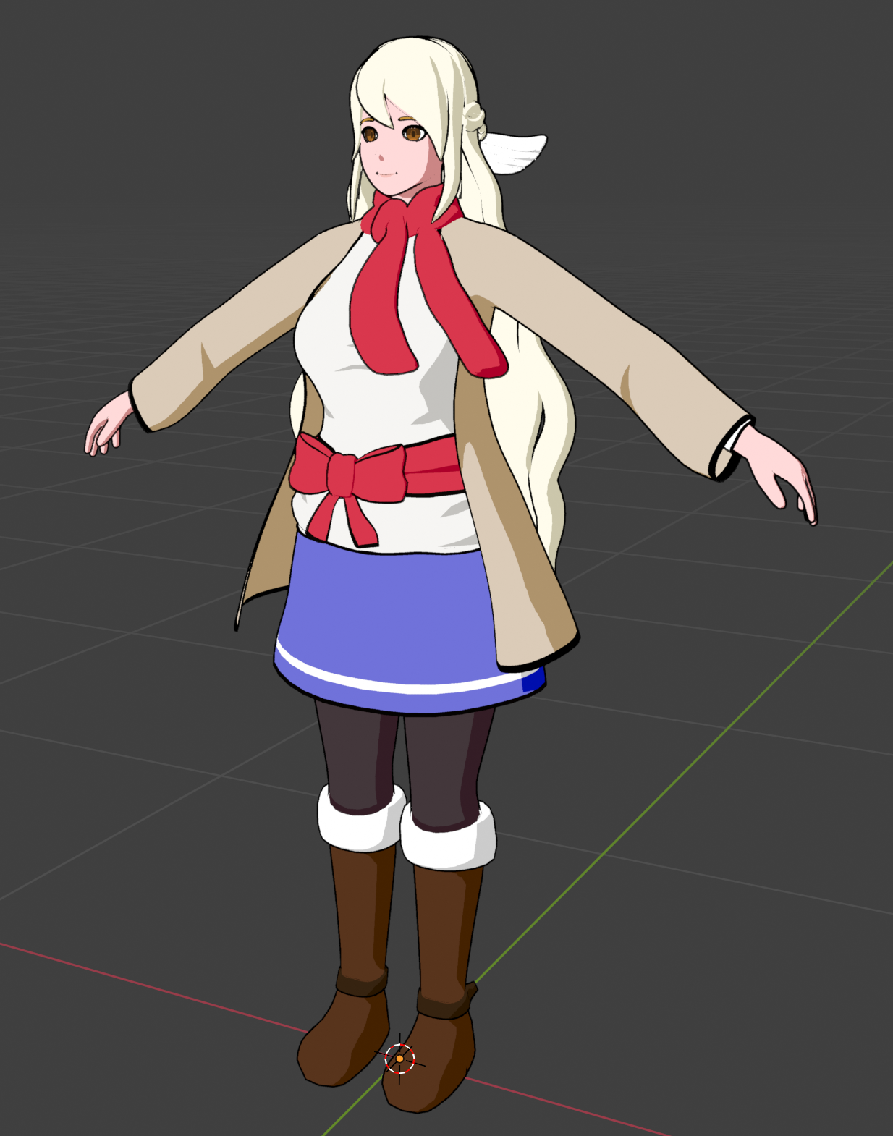
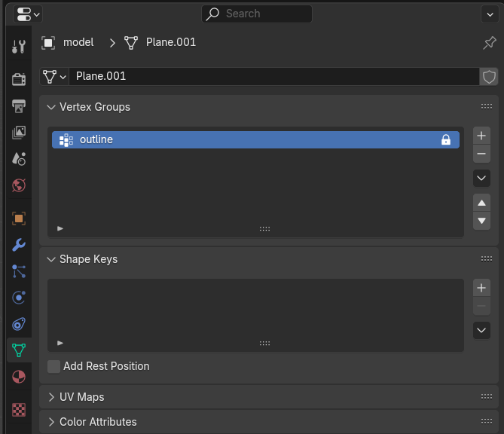
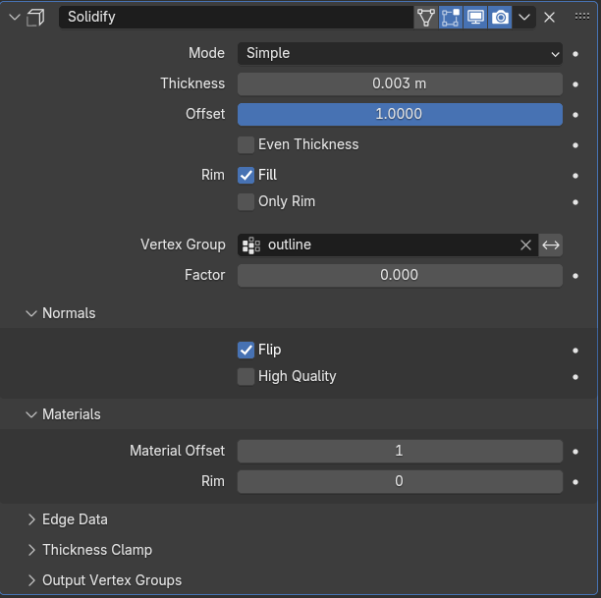
Controlling the Outline Weights
Your outlines will probably look awful, but that’s OK! We’ll fix that now.
By using weight painting, we can control the thickness of the Solidify modifier freely with a vertex group
Create a new vertex group, called “outline”
Assign “outline” to the Solidify modifier

Slide 26
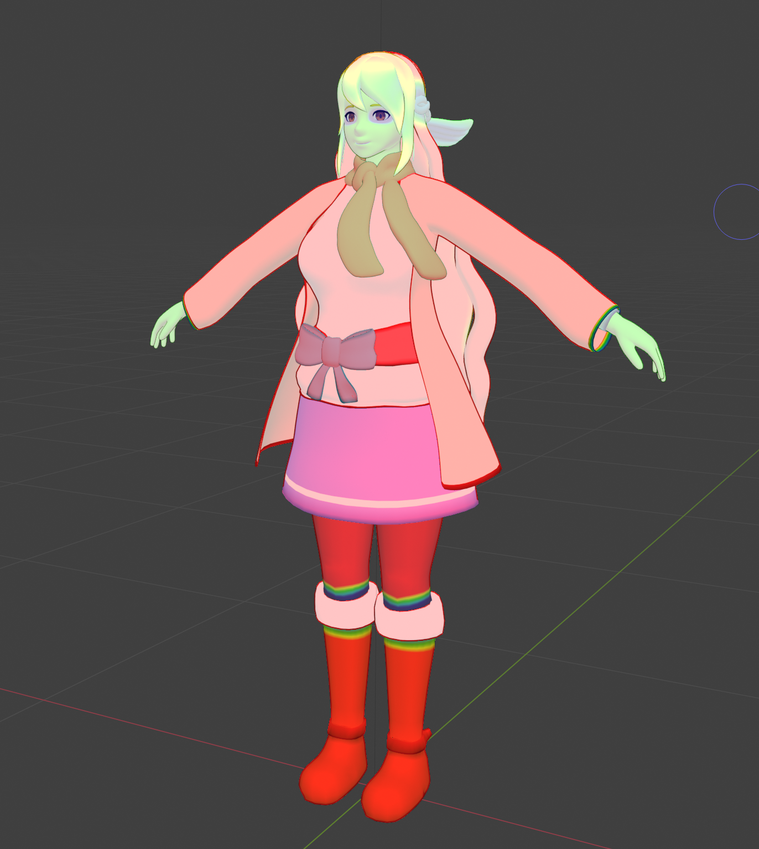
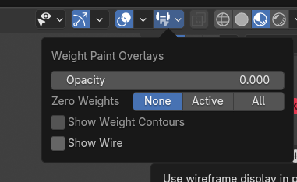
Outline Weight Painting
Select the “outline” vertex group in the outliner
Enter weight paint mode
Paint lower than 1 in some areas where you see clipping or to your taste
Can adjust the Weight Paint Overlays opacity to 0 to make it easier to see
Common areas to have < 1 weight:
Face - 0.25
Eyes and mouth - 0
Hands - 0.25
Hair tips - 0.25 or less
Once you’re done, use Weights > Smooth a few times to clean up the look

Slide 27
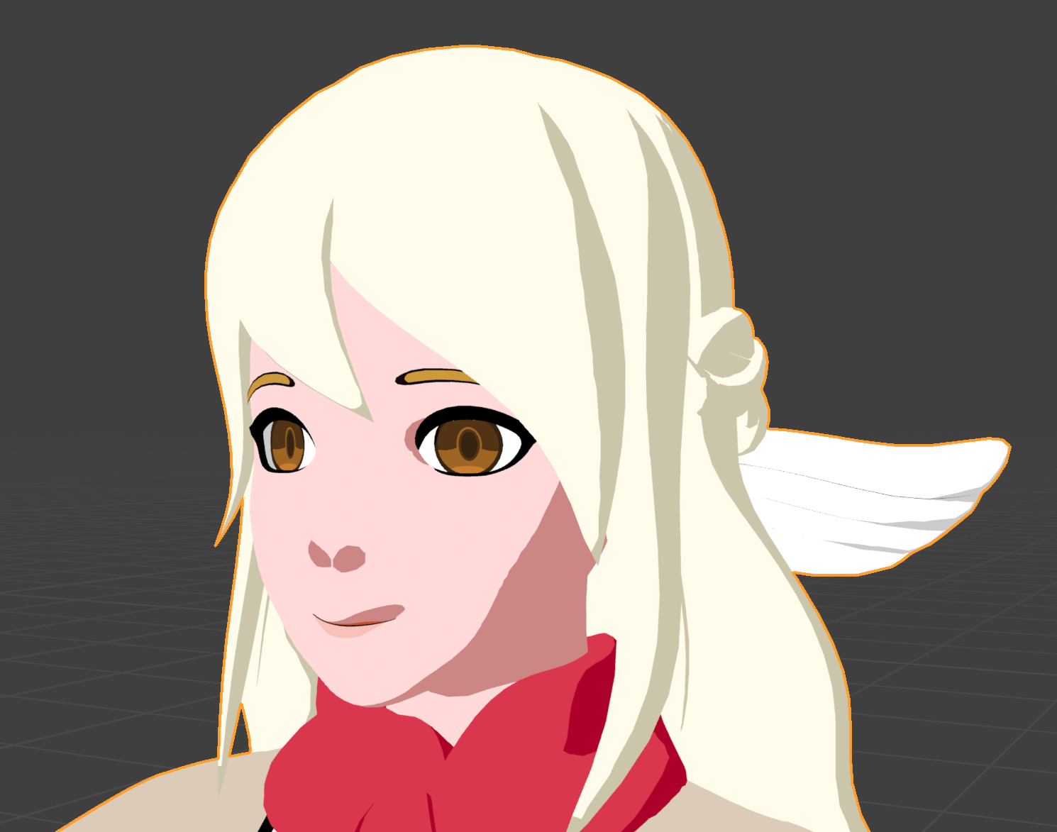
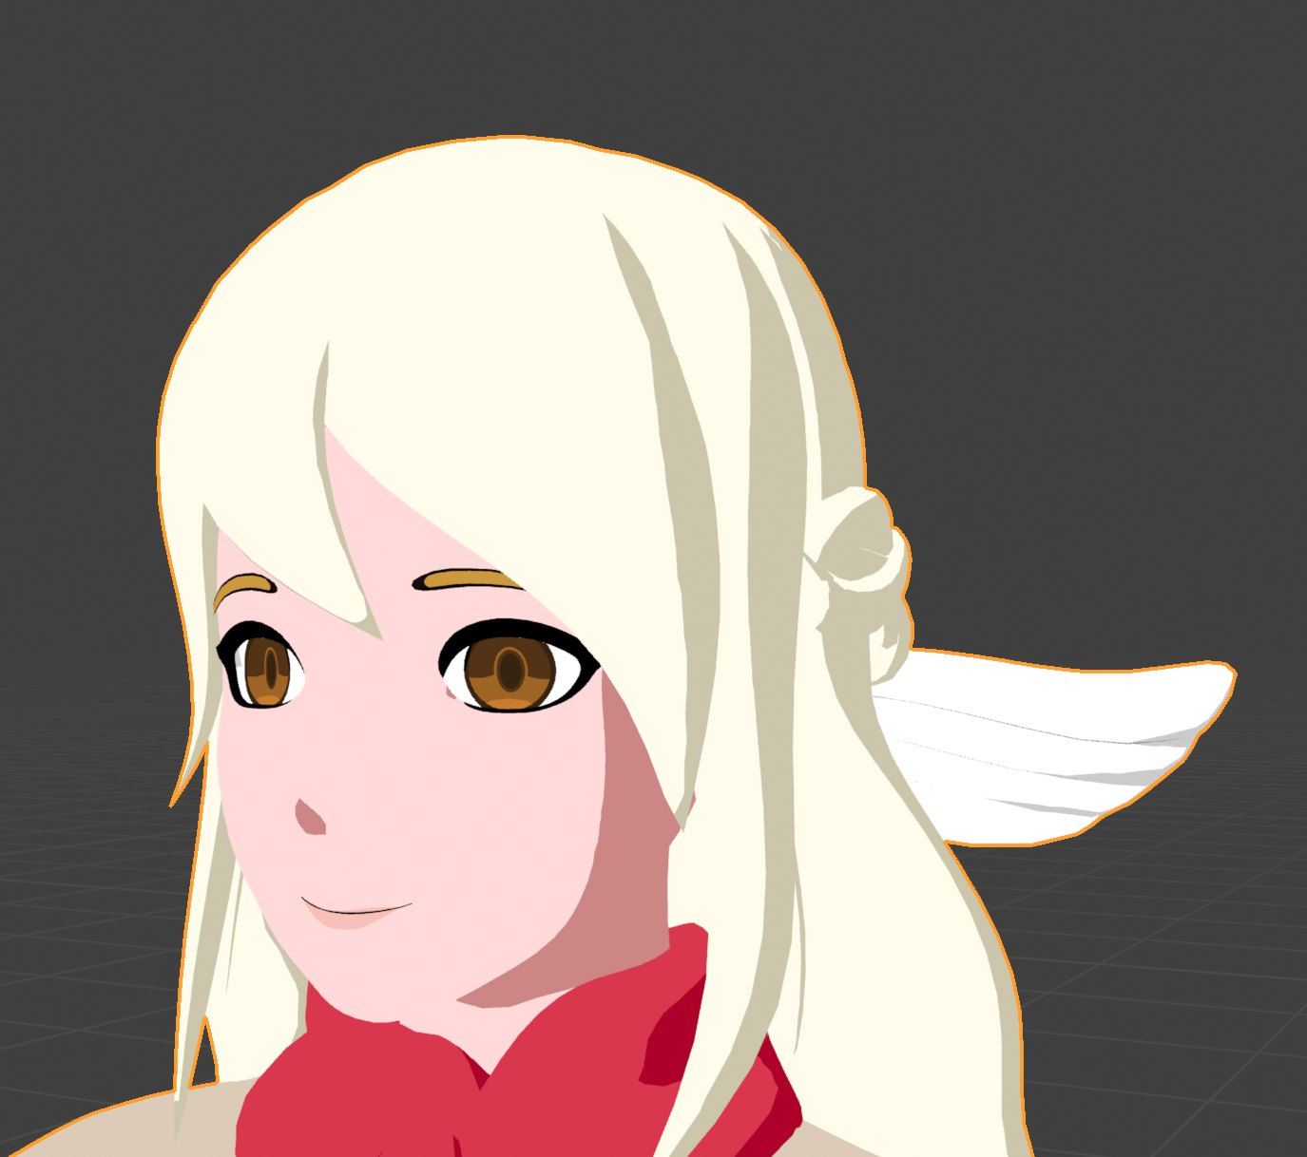
Normal Editing
Normals are rays that face away from vertices and faces
They are compared to the light angle to determine if a face is lit or not
Without normal editing, our character’s face will look strange and not “anime”
We have the ability to change the individual normal angles to improve the look

Slide 28
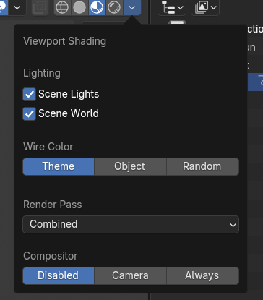
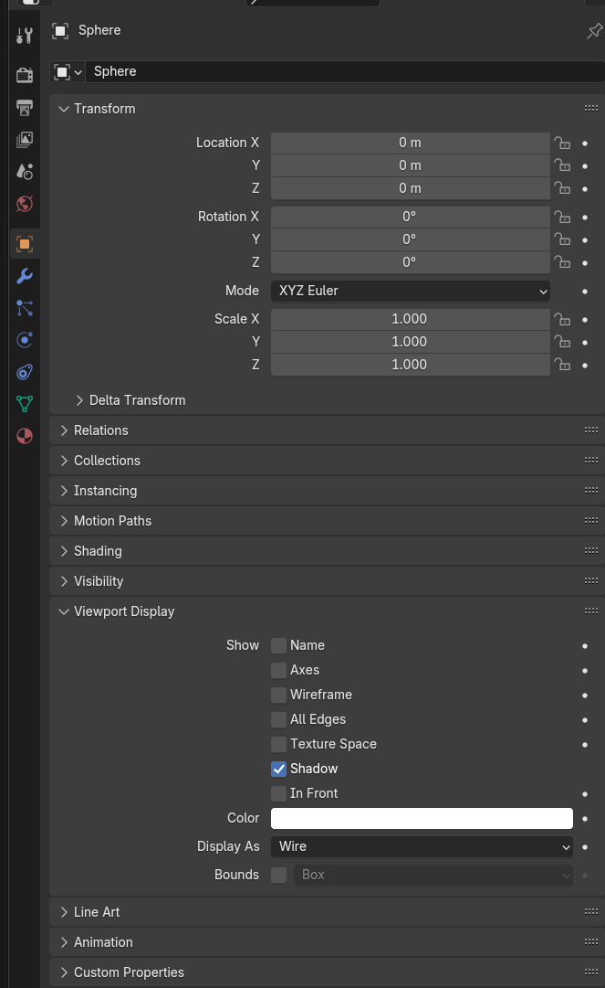
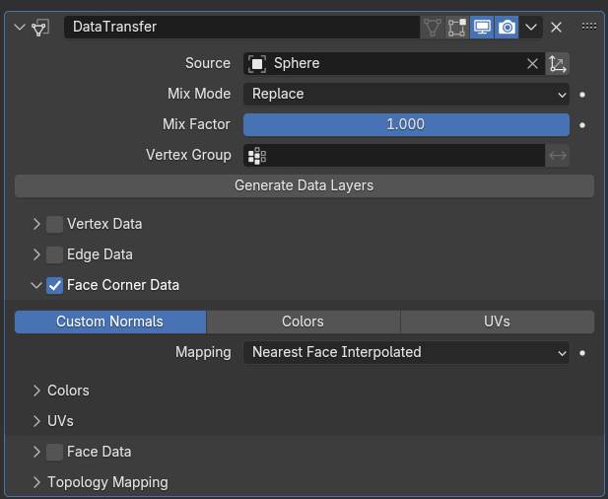
Editing Face Normals
We’ll use Blender’s Data Transfer modifier but there are many methods to do this
Create a UV Sphere mesh
Change the Viewport display to Wire on Sphere to see better
Adjust it to be just larger than the head in Edit Mode
Add a Data Transfer modifier that copies face normals from the sphere
Adjust the sphere in Edit mode to get the shading you want

Slide 29
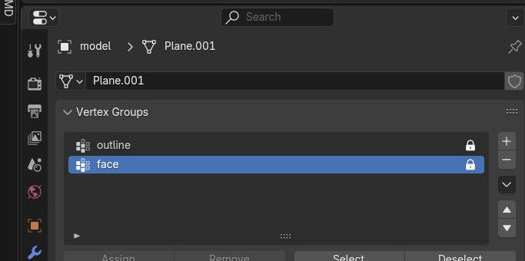
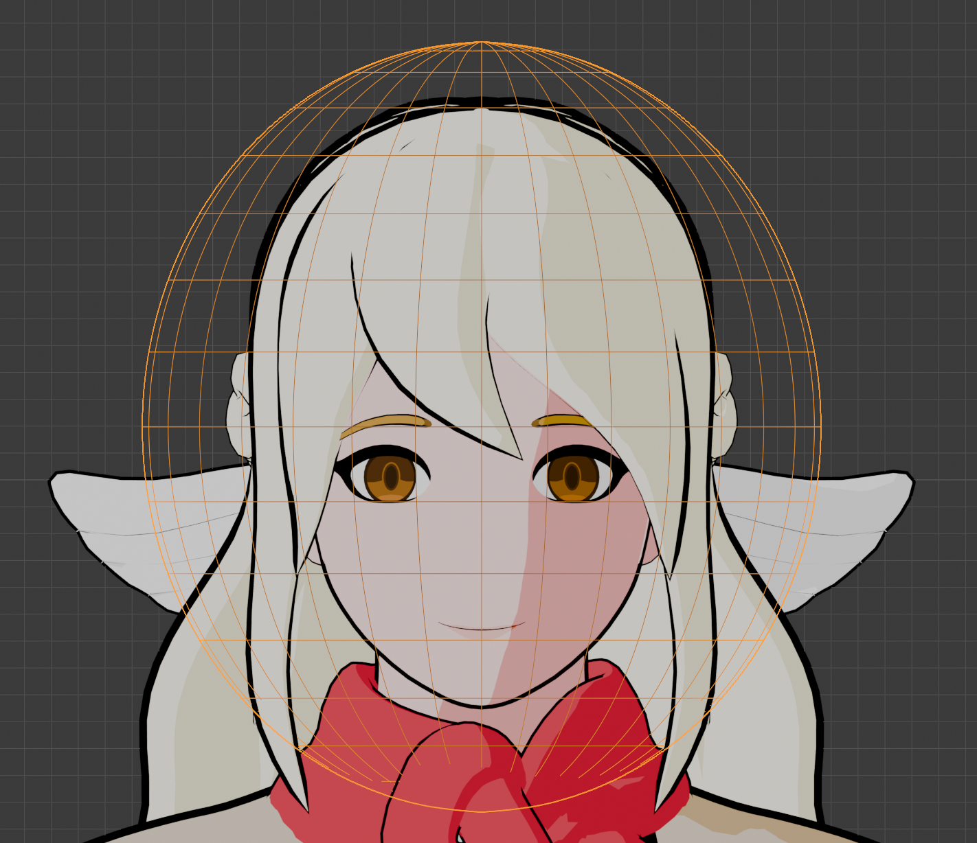
Testing Face Normals
Move the Light around to see how the normals look
Continue to adjust the sphere shape until you like it in Edit Mode
Add a vertex group that only includes the face vertices and add it to the DataTransfer modifier
Once done, add a few subdivisions to the sphere, then apply the DataTransfer modifier
Hide and disable the sphere so you can reapply it again if needed

Slide 30
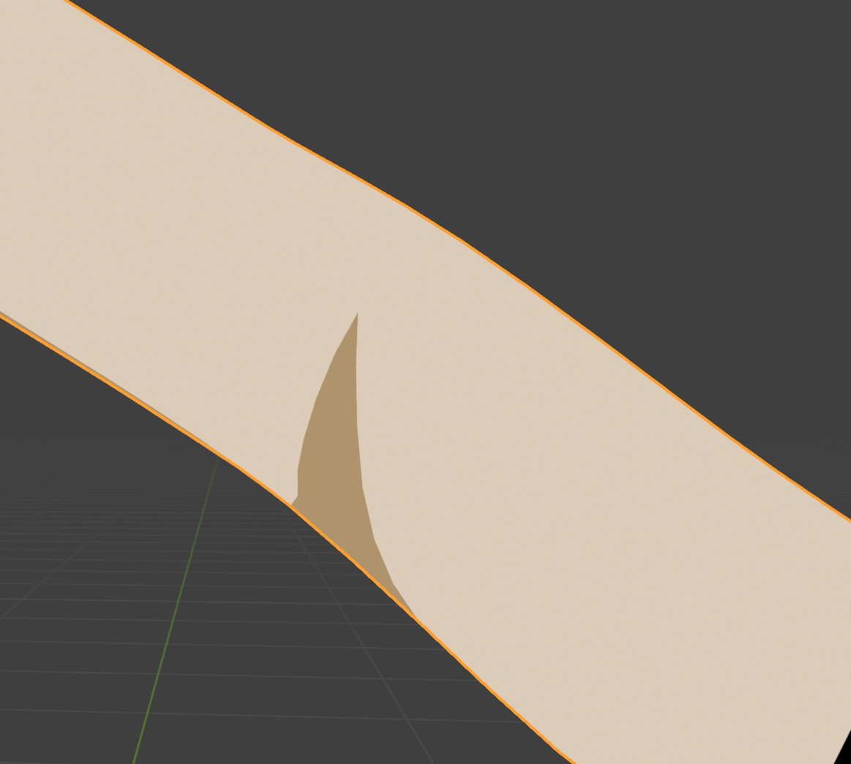
Adding Control to Our Shader
What if we wanted to control the look even further? We could give ourselves the ability to paint in custom shadows, for example
Models have the ability to store vertex colors, but they don’t have to just be used for color - they can be used to store data.
We’ll configure our vertex colors to store the outline weights as well as the custom shadows
Then we can program the shader to use those values

Slide 31
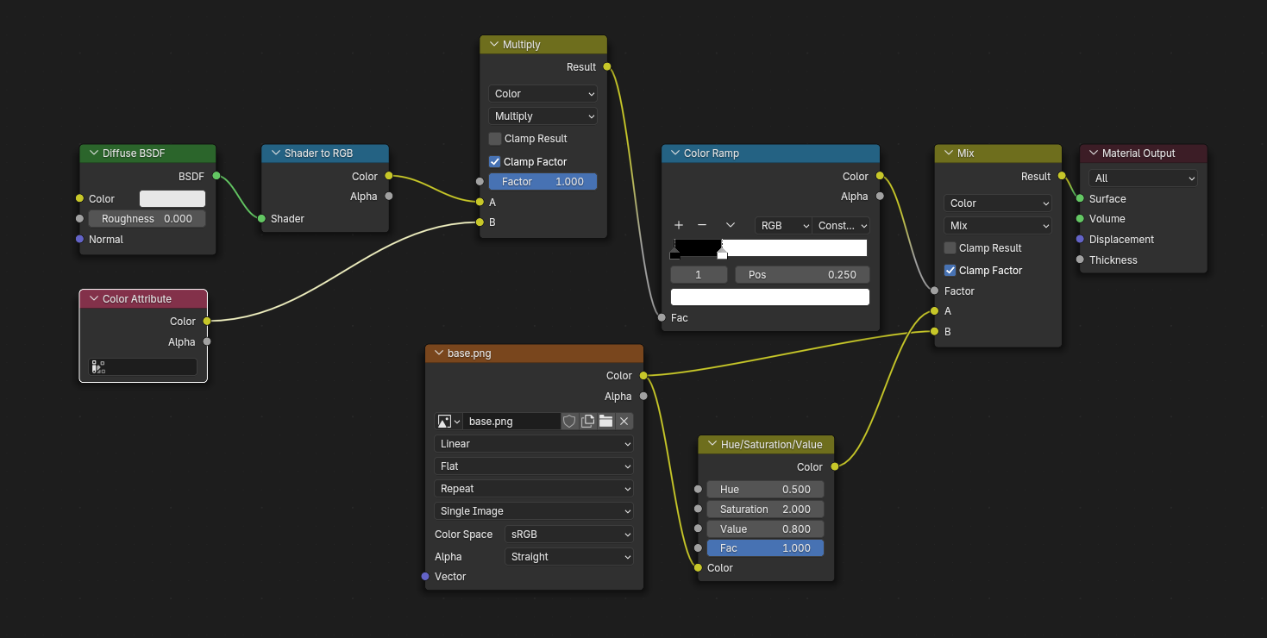
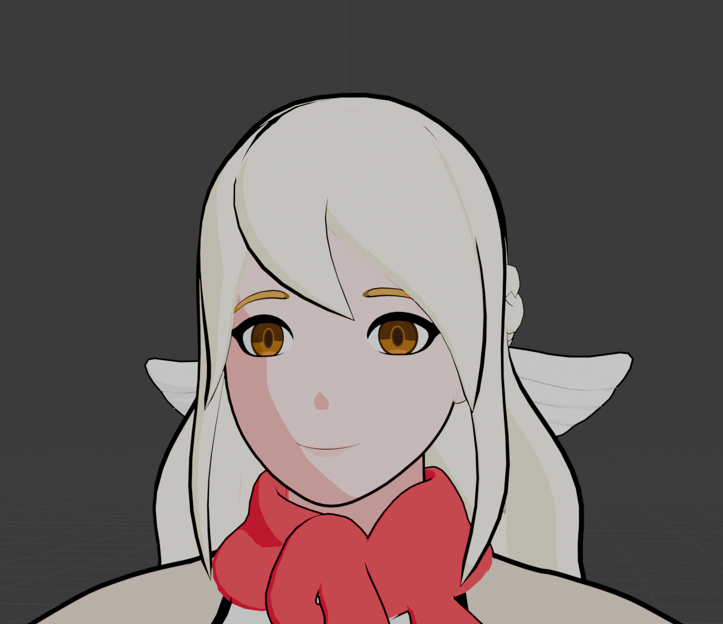
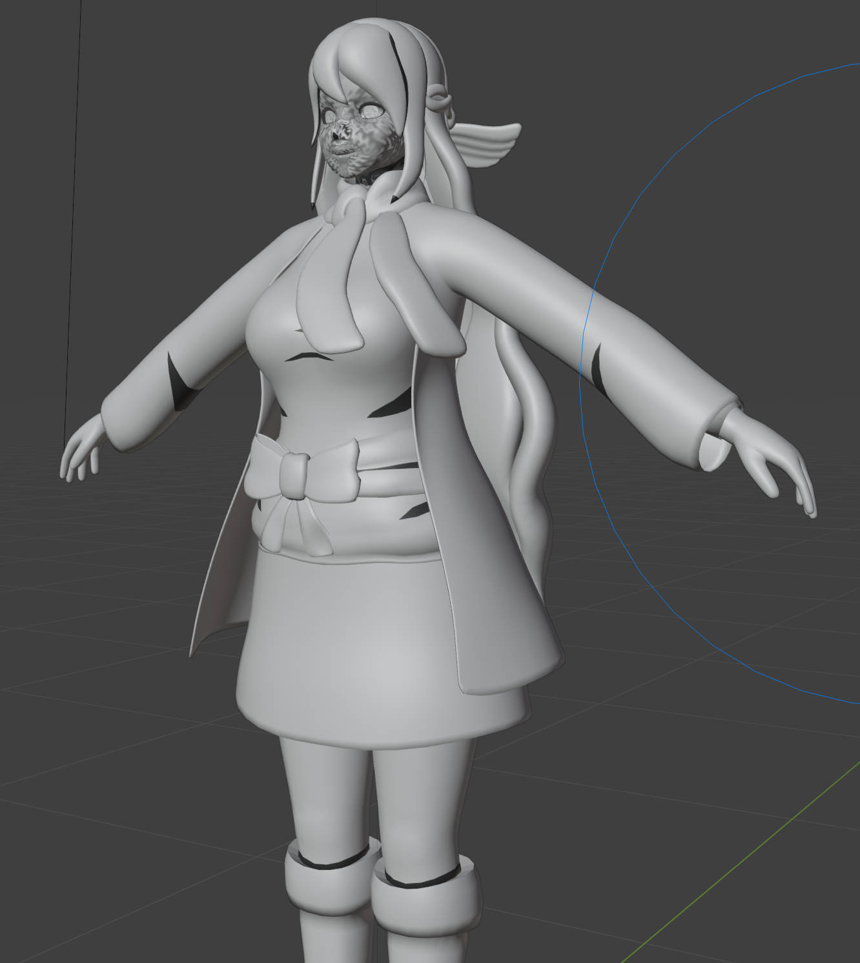
Adding Custom Shadows
Add additional logic to the shader to reference the value of the vertex colors - if the value is 1, then it’ll treat that area as shaded
Enter Vertex Paint mode to paint custom shadows with black
Feel free to add geometry to influence the shadows - making cuts won’t be harmful to the overall topology

Slide 32
Exporting to Godot

Slide 33
Preparing for Export
We have the solidify modifier and that works great in Blender, but what about Godot?
We don’t want to export our modifiers (that breaks compatibility with shape keys if we wanted to use them in the future) so we won’t export the outline
Instead, we’ll write the outline shader in Godot and it can pull the weights from the vertex colors

Slide 34
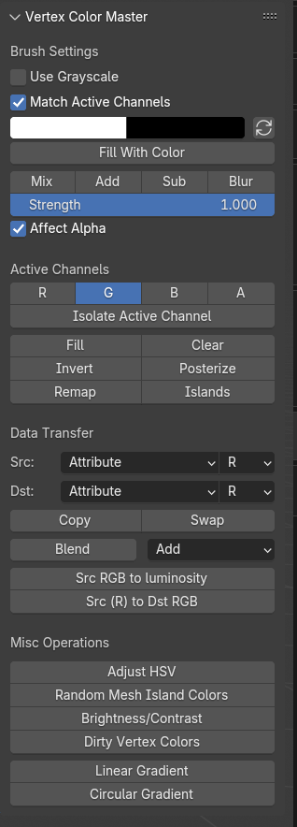
Vertex Color Master
But we also have our custom shadows, so how can we export both the custom shadows and the outline weights?
We can split the colors into RGB channels using the Vertex Color Master addon
R = outline weight, G = custom shadow, B and A channels are open slots
This lets us make the most out of the “free” data we can pass along with the model
Arc System Works used vertex colors heavily for similar uses

Slide 35
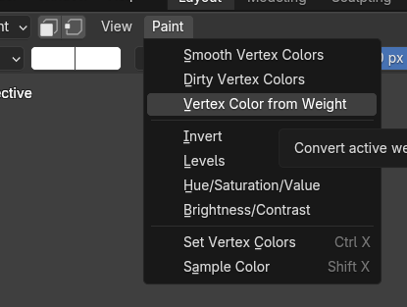
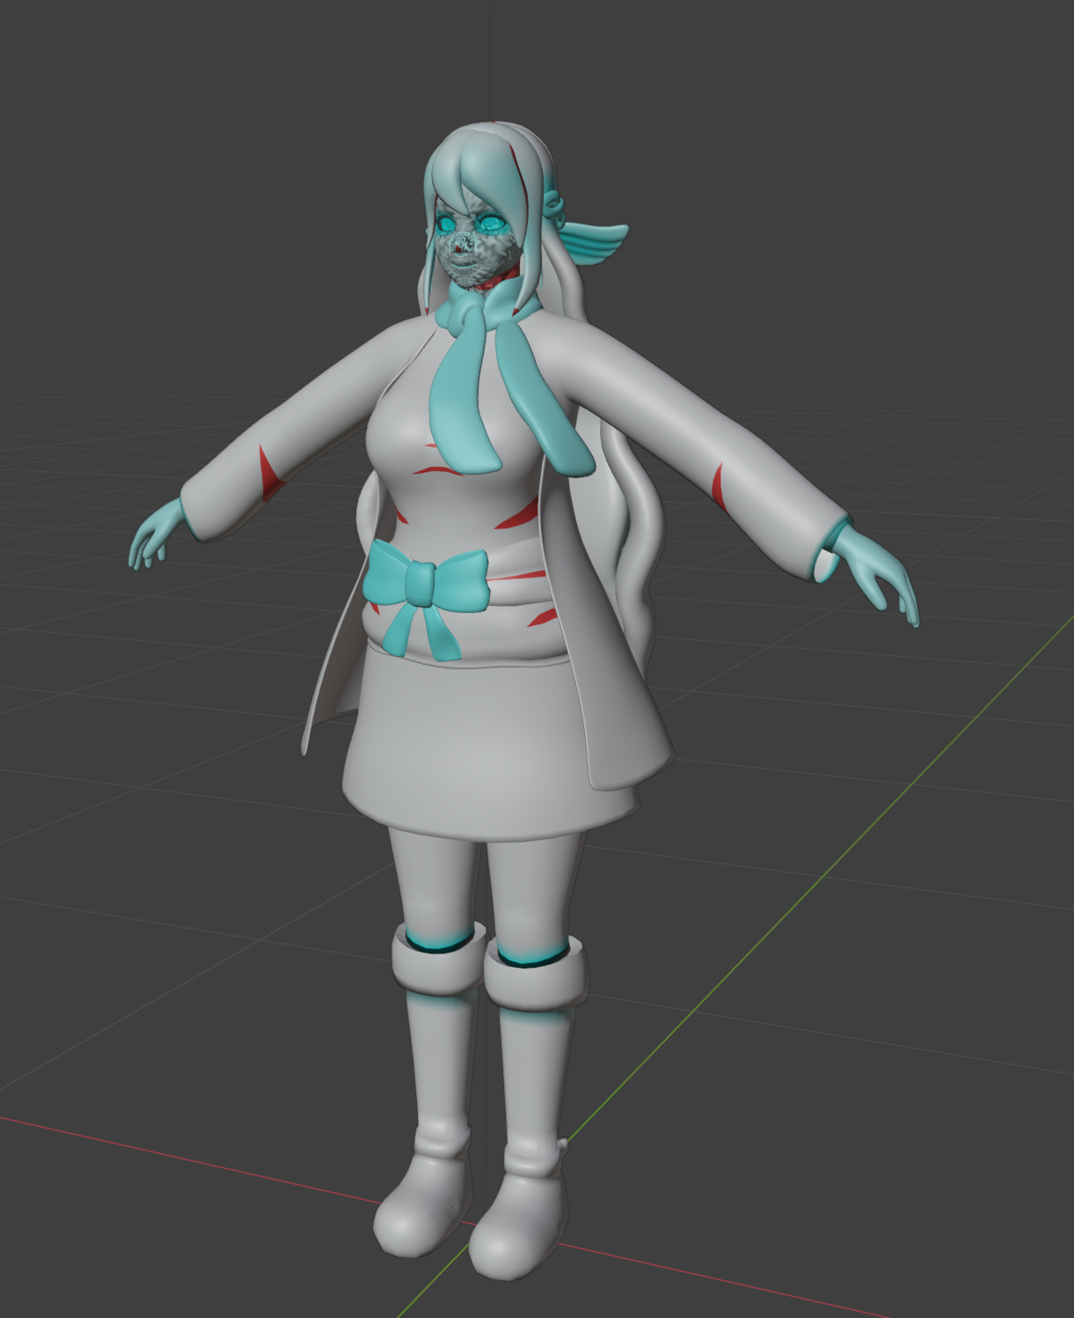
Moving the Colors to Channels
Select the model and go into Vertex Paint mode
Press N to bring up the side panel and look for “VCM”
Select “R” active Channel and “Isolate Active Channel”
Paint > Vertex Color from Weight and apply to R channel
Isolate B and A channels and paint all white (we’ll treat them as empty)
G will keep our existing shadows paint

Slide 36
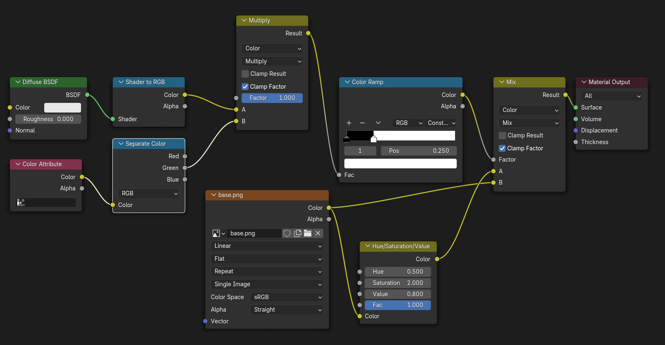
Fixing the Shader
Now that we have two channels for the vertex colors, we need to tell our shader to use just the green channel for custom shadows
Go to the Shader Editor, and add a Separate Color node between the Color Attribute node and the Multiply node
Make sure the Green channel is plugged in

Slide 37
Exporting to Godot
There are a few export formats we could use for Godot:
FBX
GLTF/GLB
BLEND file importer
While the .blend file importer is convenient, I recommend the .glb format because it’s more consistent and you can control what gets exported
We’ll go over the settings I use that get the best results in Godot

Slide 38
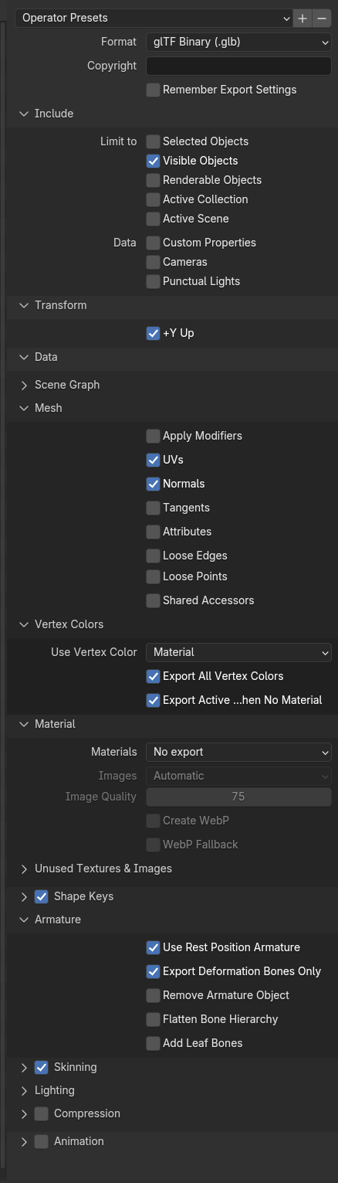
Exporting .glb to Godot
File > Export > gLTF
Settings:
Limit to Visible Objects
Data > Mesh: Uncheck Apply Modifiers
Material: No Export
The rest as defaults are good
Add this as an operator preset using the plus sign above so you can use it again
Save your model in a “models” folder in your Godot game

Slide 39
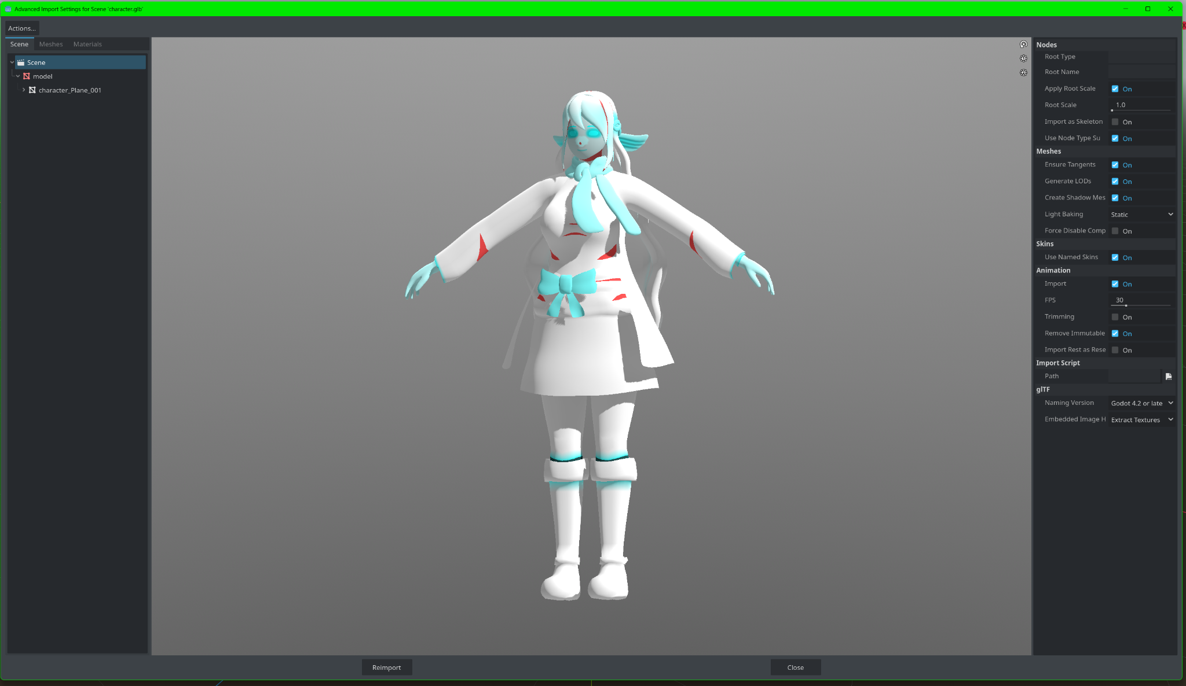
Importing the Model in Godot
After exporting the character, locate her in the “models” folder and double click the file
You should see the export settings - the defaults here are good.
Then right-click the file and create a new inherited scene

Slide 40
Recreating the Shader in Godot
Unfortunately, we will have to recreate our shader in Godot - that’s because Godot and Blender use different shader engines. That’s OK though - it’ll give us a chance to learn how Visual Shaders work.

Slide 41
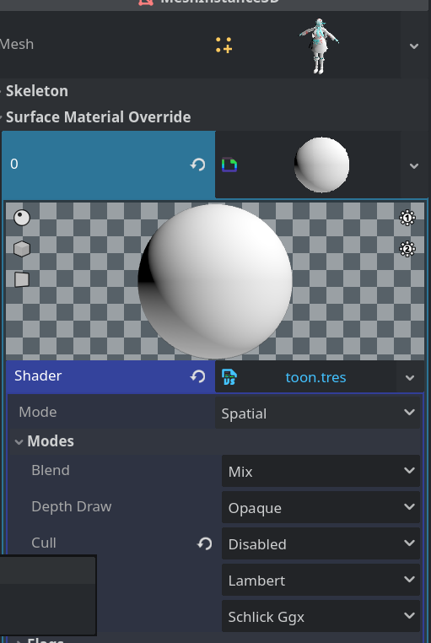
Initializing the Shader
Click on the “model” in the scene tree, and find the Surface Material Override property in the Inspector
Add a new ShaderMaterial and save it in the same folder as the character
Create a new Shader as a Visual Shader and save it in a separate “shaders” folder at the root (call it toon.tres)
Set the Cull mode to disabled so it displays on both sides of the mesh

Slide 42

The Fragment Shader
This shader transforms the base color of the model
Here, we’ll use varying to set the custom shadows to a variable, so we can pass it to the light shader
We’ll also apply the base texture’s color to the mesh here (known as albedo)
Make sure to copy your base texture into the folder with your character
We’ll make the texture a parameter so we can reuse the shader with other characters
The custom_shadows varying can be created through the “Manage Varyings” menu

Slide 43


The Light Shader
The light shader affects how light renders on the model
The bulk of the shader is here
We’ll recreate the different parts of the shader using Godot’s nodes
Remember to set your base texture as the albedo

Slide 44


Tweaking settings
See how the character looks pixelated?
We can fix that in the Project Settings
The MSAA and scaling will give us more resolution at the cost of performance
Make sure to tune this to your liking as you continue to work on your game

Slide 45



Making the Outline Shader
The Outline Shader will be applied as a second pass to the character’s material
It’ll use a Vertex shader to “grow” the vertices and then flip the normals
Then we’ll apply the outline weights
Set the flags and the Cull to “front” to make sure it renders properly

Slide 46

Tweaking the Outline Color
Just add a ColorParameter to the Fragment shader in the outline shader and now you can tweak it!

Slide 47
Bonus - Spicing Up the Shader

Slide 48

Texture Filtering
Use Filter: “Nearest” for better compatibility with the inner outlines
Since we’re using the texture atlas, this will round to the nearest color on the UV instead of blending in between

Slide 49

Linear and SRGB Color Spaces
The Type set to “Color” will use the SRGB color space, which typically results in bolder colors
This is recommended so you can stay consistent between Blender and Godot

Slide 50
Bonus - Rigging

Slide 51

Rigging with Rigify
While not the most intuitive, Rigify is supported out of the box and provides a nice control rig to use for animations
Enable the Rigify addon
Shift+A to add basic human metarig
Move around bones to match your character
Remove unwanted bones such as the face bones
Generate rig to make sure it works

Slide 52

Adding Jiggle/Secondary Bones
On metarig, Shift + A to add a new bone
Turn on vertex snapping
Make a bone chain of three bones
Name skirt1.L
Repeat around left side for skirt2.L, skirt3.L, etc.
Symmetrize
In pose mode on metarig, select each top bone and set to basic.copy_chain
Add to “skirt” bone collection to make it easier

Slide 53
Weight Painting
Parenting with automatic weights isn’t the most reliable, but we can use automatic weights algorithm on bones we choose
Separate the model into parts and parent them all to the generated armature with empty groups
Click armature, then shift click model and enter weight paint mode
Select all the bones that should influence that part of the model, then use “Assign Automatic from Bones”

Slide 54
Weight Painting Secondary Bones
Due to the nature of Rigify generating deformation bones behind the control bones, it’s hard to test weight paints directly
Duplicate the metarig, call it metarig-deform
In Edit mode, use Edit > Batch rename
Add DEF- prefix and you can weight paint on this version

Slide 55
Weight Painting Skirt
With DEF metarig, make only skirt bones visible and enter weight paint mode with skirt model
Select all bones - assign automatic (weights) from bones
Smooth all the weights with a few iterations
Select spine01 (hip) bone, and add a gradient weight down to about where first layer of skirt bones are

Slide 56
Tips and Credits

Slide 57
Tips
Simple designs are fine!
Match your desired aesthetic first, then worry about performance
Triangles are OK as long as you understand where they can be used
Test the look often - export as much as you need!
Focus on what you need to develop your game - you can always refine your characters later on!

Slide 58
Resources
Complete Character Guide YouTube Video:
https://www.youtube.com/watch?v=dd6G2S6MQ6U
Complete Character Guide Article:
https://codernunk.com/tutorials/complete-3d-character-guide/
Full Kaila 3D Model:
https://github.com/codernunk/character-assets

Slide 59
Creator Shout-Outs!
@GDC - Arc System Works’ Guilty Gear talk
@RoyalSkies - Great Blender tutorials
@2AM - Specializes in anime style
@Raymond Cripps - Interprets GDC talk well to make anime style characters
And Many More! See full list here:
https://codernunk.com/tutorials/complete-3d-character-guide/#resources-and-other-creators

Slide 60
My Socials
https://www.youtube.com/@codernunk
https://codernunk.com
https://bsky.app/profile/codernunk.bsky.social

Slide 61

Thank you!

